Slide 1
A Tool for Signal Synthesis & Analysis
Robert J. Marks II,
Distinguished Professor of Electrical and Computer Engineering
Baylor University r.marks@ieee.org http://RobertMarks.org/
POCS:

Slide 2
Outline
POCS: What is it?
  Convex Sets
  Projections
  POCS
Applications
  The Papoulis-Gerchberg Algorithm
  Neural Network Associative Memory
  Resolution at sub-pixel levels
  Radiation Oncology / Tomography
  JPG / MPEG repair
  Missing Sensors
Generalized Alternating Projections
  Ambiguity Function Synthesis
  The Gerchberg-Saxton Algorithm

Slide 3
POCS: What is a convex set?
In a vector space, a set C is convex iff ∀
and ,

Slide 4
POCS: What is a convex set?
In a vector space, a set C is convex iff ∀
and ,
C

Slide 5
POCS: Example convex sets
Convex Sets
Sets Not Convex

Slide 6
POCS: Example convex sets
Convex Sets
Sets Not Convex

Slide 7

POCS: Example convex sets
Bounded Signals – a box
$$x[n]$$
u
n
0

Slide 8







POCS: Example convex sets
Bounded Signals – a box
$$x[2]$$
$$u$$
$$\vec{x }$$
$$x[n]$$
u
n
$$u$$
$$x[1]$$
0
$$u$$
$$x[3]$$

Slide 9
POCS: Example convex sets in a Hilbert space
Bounded Signals – a box
u
x(t)
t
●
If  ≤ x(t) ≤ u and  ≤ y(t) ≤ u,
then, if 0 ≤ λ ≤ 1
● ≤ λ x(t)+(1- λ) y(t) ≤ u.

Slide 10
POCS: Example convex sets in a Hilbert space
Identical Middles – a plane
$$x[n]$$
1
n
1 2 3

Slide 11






POCS: Example convex sets in a Hilbert space
Identical Middles – a plane
$$x[n]$$
$$x[2]$$
1
$$C$$
n
$$x[1]$$
$$\vec{x }$$
1 2 3
$$1$$
$$x[3]$$

Slide 12
POCS: Example convex sets in a Hilbert space
Identical Middles – a plane
x(t)
c(t)
ℑ
t
y(t)
c(t)
t
ℑ

Slide 13

POCS: Example convex sets in a Hilbert space
Fixed Area Signals – a plane
$$x[n]$$
n
1 2 3

Slide 14








POCS: Example convex sets in a Hilbert space
Fixed Area Signals – a plane
$$x[n]$$
$$x[2]$$
$$A$$
$$C$$
$$\vec{x }$$
$$A$$
1 2 3
$$x[1]$$
$$A$$
$$x[3]$$

Slide 15
POCS: Example convex sets in a Hilbert space
Fixed Area Signals – a plane

Slide 16
POCS: Example convex sets in a Hilbert space
Fixed Area Signals – a plane
x(t)
y(t)
A
A
t
t

Slide 17
POCS: Example convex sets in a Hilbert space
Bounded Energy Signals – a ball

Slide 18



POCS: Example convex sets in a Hilbert space
Bounded Energy Signals – a ball
$$x[2]$$
2E
$$x[1]$$
$$x[3]$$

Slide 19
POCS: Example convex sets in a Hilbert space
Bounded Energy Signals – a ball
2E

Slide 20
POCS: Example convex sets in a Hilbert space
Bounded Energy Signals – a ball
Triangle Inequality
2E

Slide 21
POCS: Example convex sets in a Hilbert space
Bandlimited Signals – a plane (subspace)
B = bandwidth
If x(t) is bandlimited and y(t) is bandlimited, then so is
z(t) = λ x(t) + (1- λ) y(t)

Slide 22
POCS: Example convex sets in a Hilbert space
Tomographic Projections
P
y
p
x

Slide 23
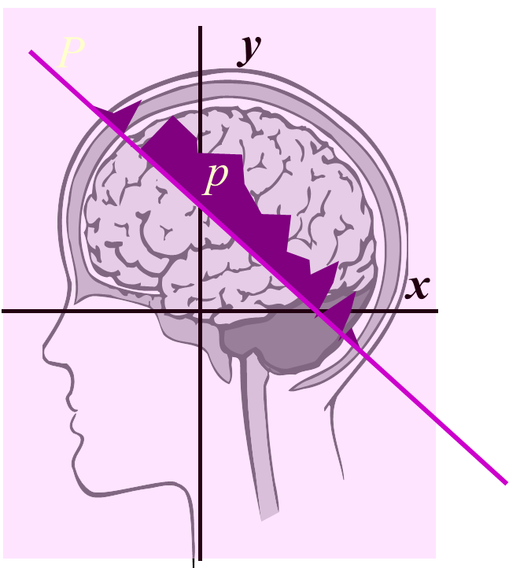
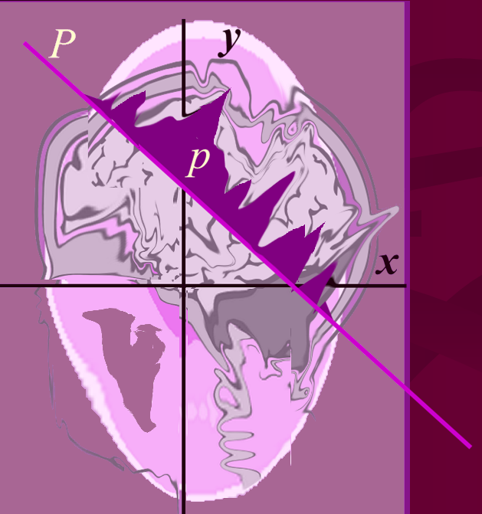
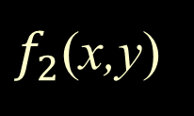
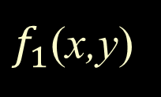
POCS: Example convex sets in a Hilbert space
Identical Tomographic Projections – a plane
$f_{1}$(x,y)
$f_{2}$(x,y)

Slide 24
POCS: Example convex sets in a Hilbert space
Identical Tomographic Projections – a plane
$f_{1}$(x,y)
$f_{2}$(x,y)
Same as constant area

Slide 25
POCS: What is a projection onto a convex set?
For every (closed) convex set, C, and every vector, x, in a Hilbert space, there is a unique vector in C, closest to x.
This vector, denoted P_{C} x, is the projection of x onto C:
C
P_{C} x
x

Slide 26
POCS: What is a projection onto a convex set?
For every (closed) convex set, C, and every vector, x, in a Hilbert space, there is a unique vector in C, closest to x.
This vector, denoted P_{C} x, is the projection of x onto C:
C
P_{C} x
x
P_{C} y
y

Slide 27
POCS: What is a projection onto a convex set?
For every (closed) convex set, C, and every vector, x, in a Hilbert space, there is a unique vector in C, closest to x.
This vector, denoted P_{C} x, is the projection of x onto C:
C
P_{C} x
x
P_{C} z=
z
P_{C} y
y

Slide 28
POCS: What is a projection onto a convex set?
For every (closed) convex set, C, and every vector, x, in a Hilbert space, there is a unique vector in C, closest to x.
This vector, denoted P_{C} x, is the projection of x onto C:
C
Projections are
idempotent.
P_{C} x
x
P_{C} z=
z
P_{C} y
y

Slide 29





POCS: Example projections
Bounded Signals – a box
$y[n]$ $∉C$
u
$$y[2]$$
$$u$$
0
n
$\vec{y }$ $∉C$
$$u$$
$$y[1]$$
$$u$$
$$y[3]$$

Slide 30


POCS: Example projections
Bounded Signals – a box
$y[n]$ $∉C$
u
$$y[2]$$
$$℘_{C}\vec{y}$$
$$u$$
0
n
$\vec{y }$ $∉C$
$$℘_{C}y[n]$$
$$u$$
$$y[1]$$
u
$$u$$
$$y[3]$$
n
0

Slide 31

Example Projections
Bounded Signals – a box
y(t) $∉$C
u
t
●

Slide 32
Example Projections
Bounded Signals – a box
P_{C} y(t)
y(t)
u
t
●

Slide 33
Example Projections
Bounded Signals – a box
P_{C} y(t)
y(t)
u
t
●
P_{C} y(t)
y(t)

Slide 34







POCS: Example convex sets in a Hilbert space
Identical Middles – a plane
$$y[n] ∉C$$
1
$$y[2]$$
$$C$$
n
1 2 3
$$y[1]$$
$$1$$
$$y[3]$$
$\vec{y }$ $∉C$

Slide 35


POCS: Example convex sets in a Hilbert space
Identical Middles – a plane
$$y[n] ∉C$$
1
$$y[2]$$
$$C$$
$$℘_{C}\vec{y}$$
n
1 2 3
$$y[1]$$
1
$$1$$
$$y[3]$$
$$℘_{C}y[n]$$
$\vec{y }$ $∉C$
n
1 2 3

Slide 36

Example Projections
Identical Middles – a plane
y(t)
y(t)
C
t
ℑ
P_{C} y(t)
P_{C} y(t)
c(t)
t
ℑ

Slide 37

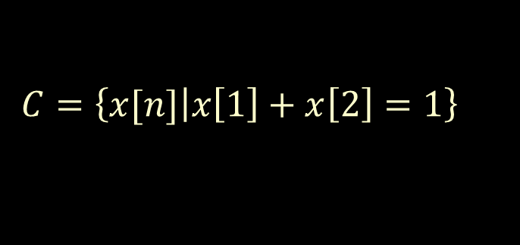

Example Projections
Constant Area Signals
      – a plane (linear variety)
$C=\left\{x[n]\left|x\left[1\right]+x\left[2\right]=1\right.\right\}$
$$y[n] ∉C$$
2
n
y[2]
$\vec{y }$ $∉C$
1
1
1 2
1 2
x[1]

Slide 38


Example Projections
Constant Area Signals
      – a plane (linear variety)
$C=\left\{x[n]\left|x\left[1\right]+x\left[2\right]=1\right.\right\}$
$$y[n] ∉C$$
2
n
y[2]
$\vec{y }$ $∉C$
1
1
1 2
$$℘_{C}\vec{y}$$
$$℘_{C}y[n]$$
2
1 2
x[1]
n
1

Slide 39
Example Projections
Constant Area Signals
      – a plane (linear variety)
$C=\left\{x[n]\left|x\left[1\right]+x\left[2\right]=1\right.\right\}$
$$y[n] ∉C$$
2
n
y[2]
$\vec{y }$ $∉C$
1
1
1 2
$$℘_{C}\vec{y}$$
$$℘_{C}y[n]$$
2
1 2
x[1]
n
1
The same value (in this example, 1) is subtracted (or added) to every value.
Water Analogy

Slide 40
Example Projections
y(t)
C
Constant Area Signals
      – a plane (linear variety)
P_{C} y(t)
Same value added to each element.
Water Analogy

Slide 41

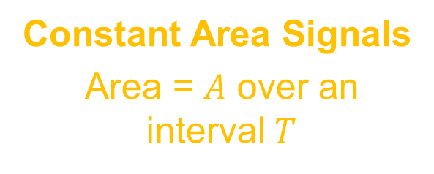

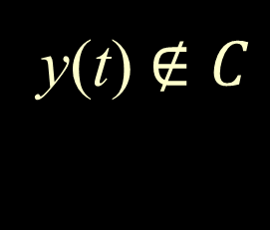



Example Projections
y(t) $∉C$
Constant Area Signals
Area = $A$ over an interval $T$
$$t$$
$$T$$
$$℘_{C}y[n]$$
$$Area=A$$
Water Fill
$$t$$

Slide 42
Example Projections
Bandlimited Signals – a plane (subspace)
y(t)
C
Low Pass Filter:
Bandwidth B
y(t)
P_{C} y(t)
P_{C} y(t)

Slide 43
POCS: Example Projections
Tomographic Projections
P
y
Should sum to p
x
Candidate Image

Slide 44
POCS: Example Projections
Tomographic Projections
P
y
Raise (or lower) the water on the candidate image until the sum is p along the line P.
p
x

Slide 45
Example Projections
Bounded Energy Signals – a ball
y(t)
2E

Slide 46
Example Projections
Bounded Energy Signals – a ball
y(t)
P_{C} y(t)
2E

Slide 47
Example Projections
Bounded Energy Signals – a ball
y(t)
P_{C} y(t)
2E

Slide 48
The intersection of convex sets is convex
C₁
C₁ ∧ C₂
C₂

Slide 49
The intersection of convex sets is convex
C₂
C₁
C₁
C₁ ∧ C₂
C₂
} C₁ ∧ C₂

Slide 50
Alternating POCS will converge to a point common to both sets
C₂
C₁
= Fixed Point

Slide 51
Alternating POCS will converge to a point common to both sets
C₂
C₁
= Fixed Point
The Fixed Point is generally dependent on initialization

Slide 52
Bounded: $0≤x\left[n\right]≤4$ and Area: $x\left[1\right\}+x\left[2\right\}+x\left[3\right]=2$
4
Start
0
n

Slide 53
Bounded: $0≤x\left[n\right]≤4$ and Area: $x\left[1\right\}+x\left[2\right\}+x\left[3\right]=2$
4
Start
4
Bounded
0
0
n
n

Slide 54
Bounded: $0≤x\left[n\right]≤4$ and Area: $x\left[1\right\}+x\left[2\right\}+x\left[3\right]=2$
4
Start
4
Bounded
0
0
n
n
Sum to 2
2
-2
n

Slide 55
Bounded: $0≤x\left[n\right]≤4$ and Area: $x\left[1\right\}+x\left[2\right\}+x\left[3\right]=2$
4
Start
4
Bounded
0
0
n
n
Sum to 2
2
2
Bounded
-2
-2
n

Slide 56


Bounded: $0≤x\left[n\right]≤4$ and Area: $x\left[1\right\}+x\left[2\right\}+x\left[3\right]=2$
4
Start
4
Bounded
0
0
n
n
Sum to 2
2
2
Bounded
-2
-2
n
$$1\frac{1}{3}$$
Sum to 2
$$−\frac{2}{3}$$

Slide 57

Bounded: $0≤x\left[n\right]≤4$ and Area: $x\left[1\right\}+x\left[2\right\}+x\left[3\right]=2$
4
Start
4
Bounded
0
0
n
n
Sum to 2
2
2
Bounded
-2
-2
n
$$1\frac{1}{3}$$
Sum to 2
$$1\frac{1}{3}$$
$$−\frac{2}{3}$$
Bounded

Slide 58
Bounded: $0≤x\left[n\right]≤4$ and Area: $x\left[1\right\}+x\left[2\right\}+x\left[3\right]=2$
4
Start
4
Bounded
0
0
n
n
Sum to 2
2
2
Bounded
-2
-2
n
$$1\frac{1}{3}$$
Sum to 2
$$1\frac{1}{3}$$
$$−\frac{2}{3}$$
Bounded
1
Converges to➔

Slide 59
Lemma 1: Alternating POCS among N convex sets with a non-empty intersection will converge to a point common to all.
C₂
C₃
C₁

Slide 60
Lemma 1: Alternating POCS among N convex sets with a non-empty intersection will converge to a point common to all.
C₂
C₃
C₁

Slide 61


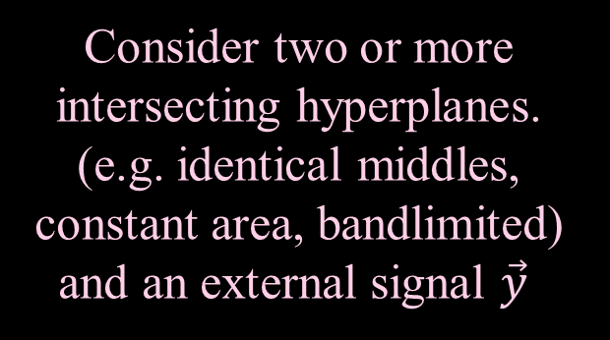

Von Neumann’s Alternating Projection Algorithm
Consider two or more intersecting hyperplanes.
(e.g. identical middles, constant area, bandlimited) and an external signal $\vec{y}$
C₁ ∧ C₂
$$C_{1}$$
$$C_{2}$$
$$\vec{y }$$

Slide 62
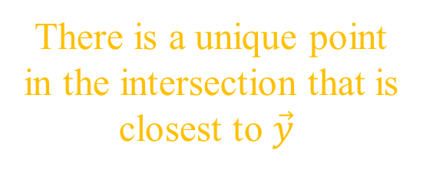
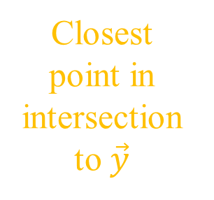
Von Neumann’s Alternating Projection Algorithm
Consider two or more intersecting hyperplanes.
(e.g. identical middles, constant area, bandlimited) and an external signal $\vec{y}$
C₁ ∧ C₂
$$C_{1}$$
There is a unique point in the intersection that is closest to $\vec{y}$
$$C_{2}$$
Closest point in intersection to $\vec{y}$
$$\vec{y }$$

Slide 63
Von Neumann’s Alternating Projection Algorithm
Consider two or more intersecting hyperplanes.
(e.g. identical middles, constant area, bandlimited) and an external signal $\vec{y}$
C₁ ∧ C₂
$$C_{1}$$
There is a unique point in the intersection that is closest to $\vec{y}$
$$C_{2}$$
Closest point in intersection to $\vec{y}$
Alternating projections will converge to that point.
$$\vec{y }$$

Slide 64
Von Neumann’s Alternating Projection Algorithm
Consider two or more intersecting hyperplanes.
(e.g. identical middles, constant area, bandlimited) and an external signal $\vec{y}$
C₁ ∧ C₂
$$C_{1}$$
There is a unique point in the intersection that is closest to $\vec{y}$
$$C_{2}$$
Closest point in intersection to $\vec{y}$
Alternating projections will converge to that point.
$$\vec{y }$$

Slide 65
Lemma 2: Alternating POCS among 2 nonintersecting convex sets will converge to the point in each set closest to the other.
C₂
C₁
Limit Cycle

Slide 66
Lemma 3: Alternating POCS among 3 or more convex sets with an empty intersection will converge to a limit cycle.
C₃
1→ 2 → 3 Limit Cycle
C₁
C₂

Slide 67
Lemma 3: Alternating POCS among 3 or more convex sets with an empty intersection will converge to a limit cycle.
Different projection operations can produce different limit cycles.
C₃
1→ 2 → 3 Limit Cycle
3→ 2 → 1 Limit Cycle
C₁
C₂

Slide 68
Lemma 3: (cont) POCS with non-empty intersection.
C₃
C₂
C₁
1→ 2 → 3 Limit Cycle

Slide 69
Lemma 3: (cont) POCS with non-empty intersection.
C₃
C₂
C₁
1→ 2 → 3 Limit Cycle
3→ 2 → 1 Limit Cycle

Slide 70

Simultaneous Weighted Projections
Take Projections
$$\vec{y }$$
C₃
C₁
C₂

Slide 71
Simultaneous Weighted Projections
Take Projections
Average
$$\vec{y }$$
C₃
C₁
C₂

Slide 72
Simultaneous Weighted Projections
Take Projections
Average
Repeat
$$\vec{y }$$
C₃
C₁
C₂

Slide 73
Simultaneous Weighted Projections
Take Projections
Average
Repeat
$$\vec{y }$$
C₃
C₁
C₂

Slide 74
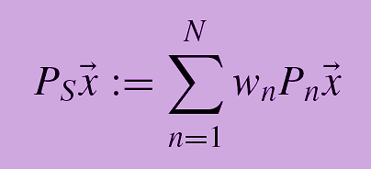
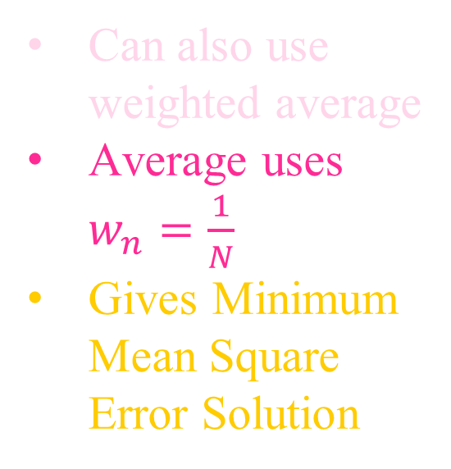
Simultaneous Weighted Projections
C₃
Can also use weighted average
Average uses $w_{n}=\frac{1}{N}$
Gives Minimum Mean Square Error Solution
C₁
C₂

Slide 75
Outline
POCS: What is it?
  Convex Sets
  Projections
  POCS
Applications
  The Papoulis-Gerchberg Algorithm
  Neural Network Associative Memory
  Resolution at sub-pixel levels
  Radiation Oncology / Tomography
  JPG / MPEG repair
  Missing Sensors
Generalized Alternating Projections
  Ambiguity Function Synthesis
  The Gerchberg-Saxton Algorithm

Slide 76
Application:
The Papoulis-Gerchberg Algorithm
Restoration of lost data in a band limited function:
g(t)
f(t)
?
?
BL
⇒
?
Convex Sets: (1) Identical Tails and (2) Bandlimited.

Slide 77
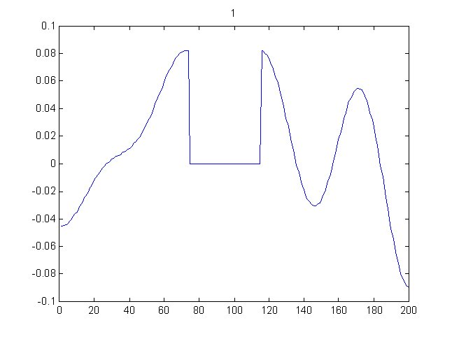
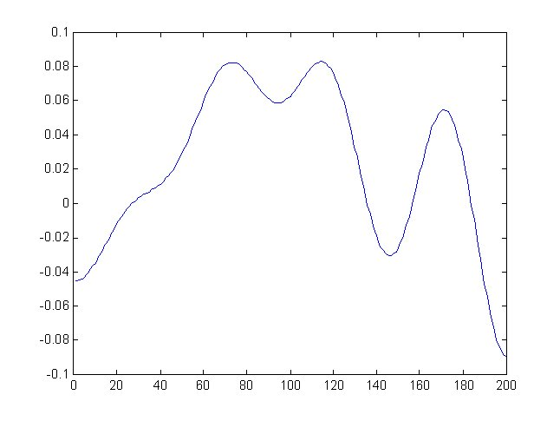
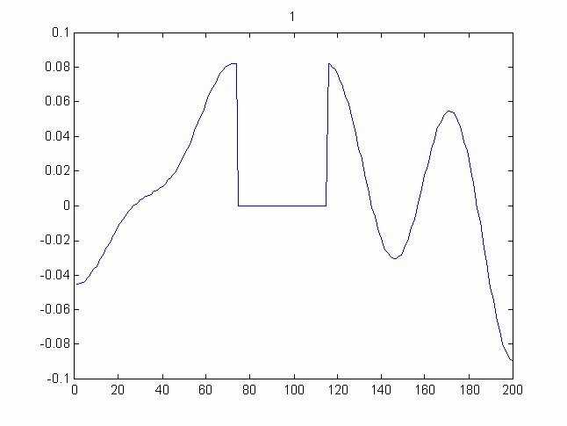
Application:
The Papoulis-Gerchberg Algorithm
Example

Slide 78
Application:
The Papoulis-Gerchberg Algorithm
Problem: Ill-posed. Ill-conditioned

Slide 79
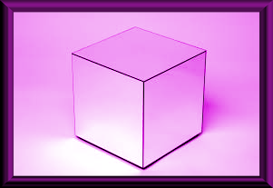
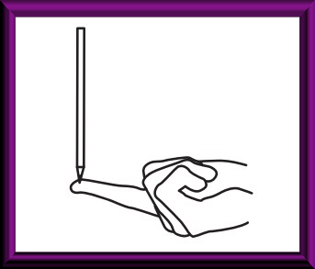
Application:
The Papoulis-Gerchberg Algorithm
Problem: Ill-posed. Ill-conditioned
Example: Sum of forces =0. Therefore no motion (?)
Problem: noise

Slide 80
Ill-Conditioned Matrix
close to singular

Slide 81
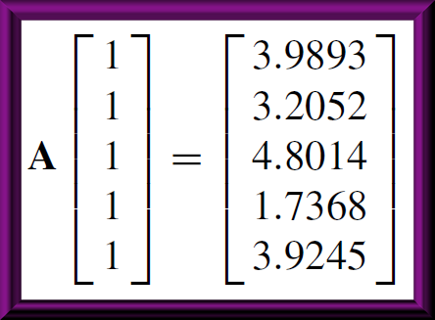
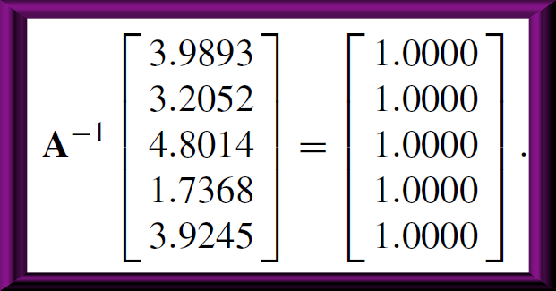
Ill-Conditioned Matrix

Slide 82
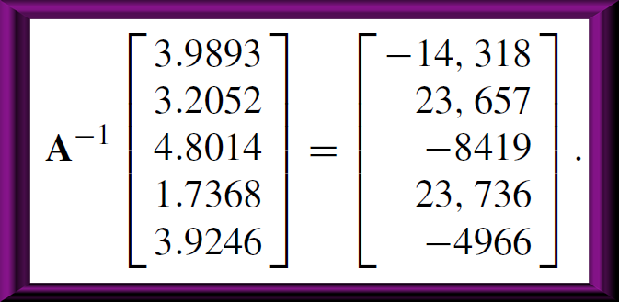
Ill-Conditioned Matrix

Slide 83
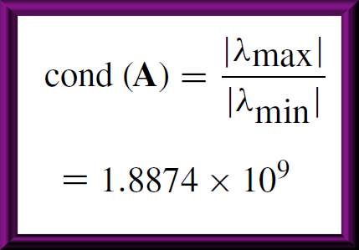
Ill-Conditioned Matrix

Slide 84
Outline
POCS: What is it?
  Convex Sets
  Projections
  POCS
Applications
  The Papoulis-Gerchberg Algorithm
  Neural Network Associative Memory
  Resolution at sub-pixel levels
  Radiation Oncology / Tomography
  JPG / MPEG repair
  Missing Sensors
Generalized Alternating Projections
  Ambiguity Function Synthesis
  The Gerchberg-Saxton Algorithm

Slide 85
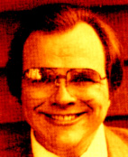
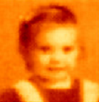
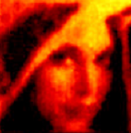
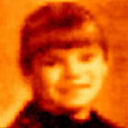
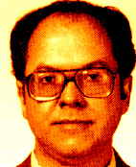
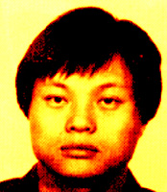


Application:
Neural Network Associative Memory
Placing the Library in Hilbert Space
A Plane!

Slide 86
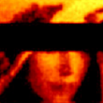
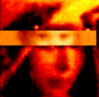
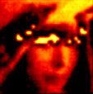
Application:
Neural Network Associative Memory
Associative Recall
Identical (known) Pixels

Slide 87
Application:
Neural Network Associative Memory
Associative Recall by POCS
Column Space
Identical Pixels

Slide 88
Application:
Neural Network Associative Memory
Associative Recall by POCS
Column Space
Identical (known) Pixels

Slide 89
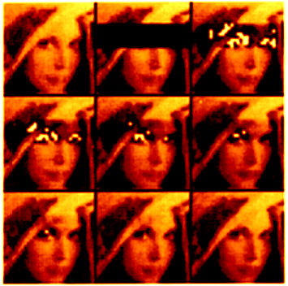
Application:
Neural Network Associative Memory
Example
1
2
3
4
5
10
19

Slide 90
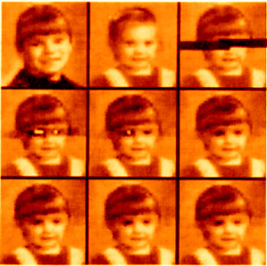
Application:
Neural Network Associative Memory
Example
0
1
2
3
4
10
19

Slide 91
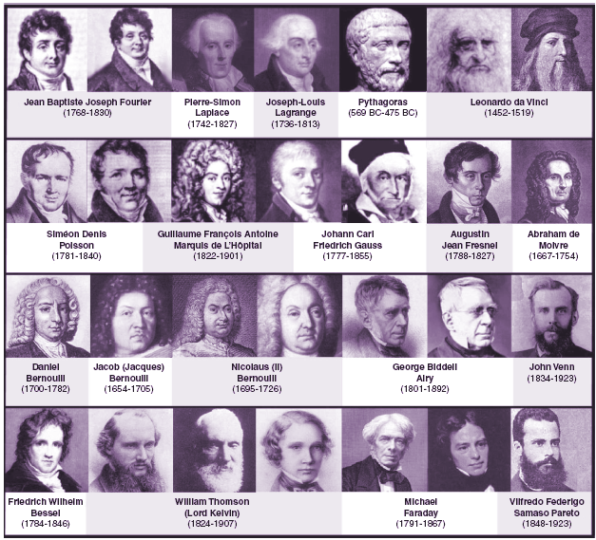
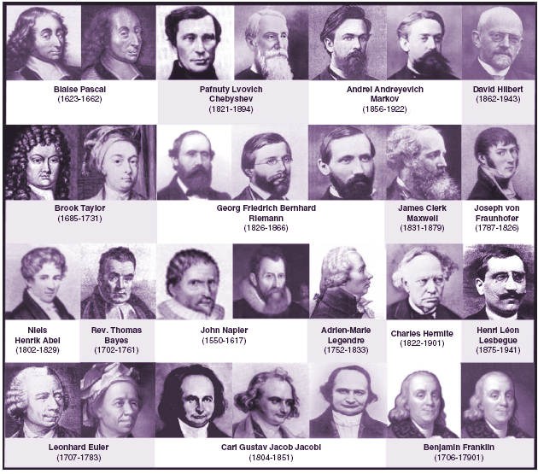
A Library of Mathematicians

Slide 92
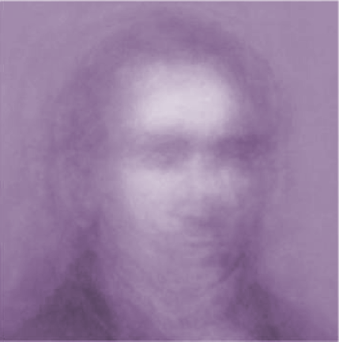
A Library of Mathematicians
What does the Average Mathematician Look Like?

Slide 93
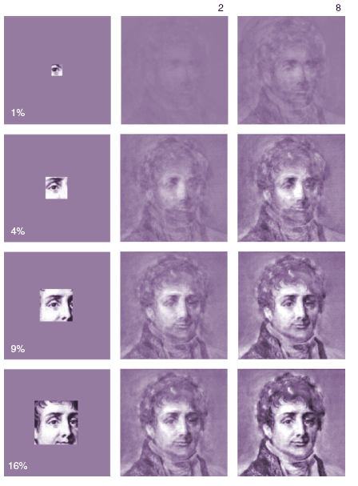
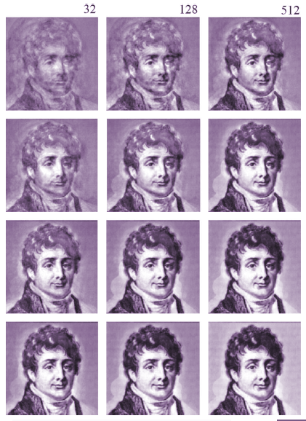
Convergence As a Function of Percent of Known Image

Slide 94
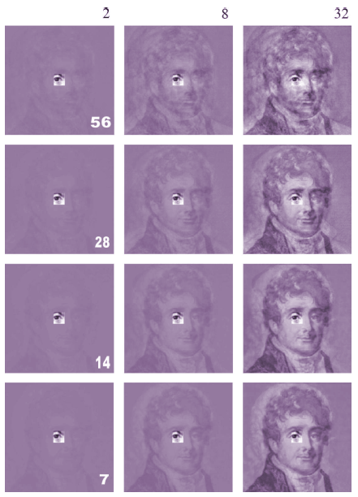
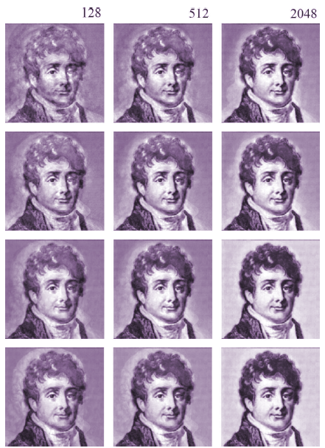
Convergence As a Function of Library Size

Slide 95
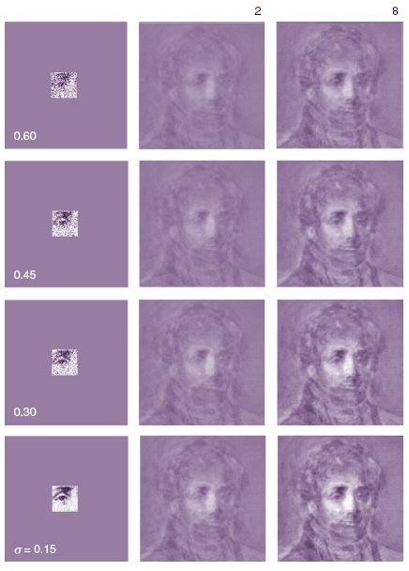
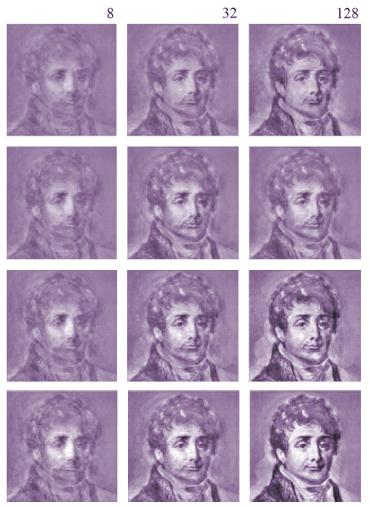
Convergence As a Function of Noise Level

Slide 96
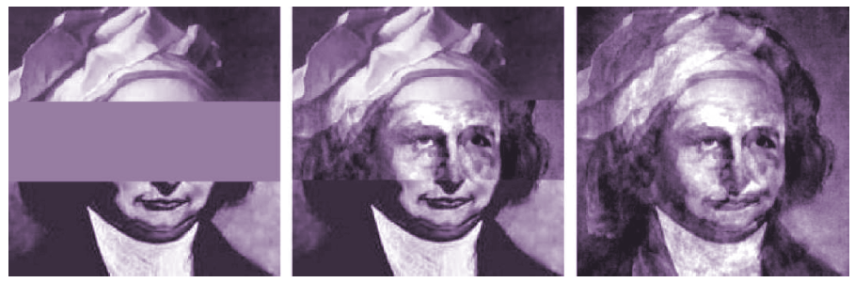
Combining Euler & Hermite

Slide 97
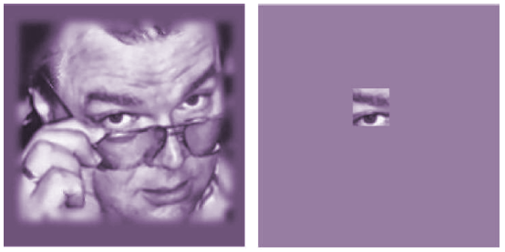
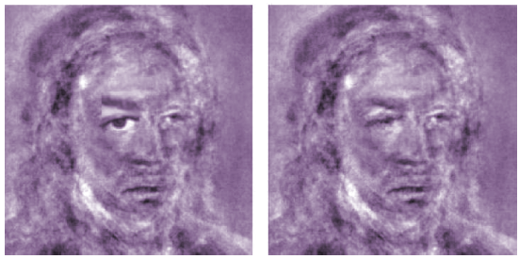
Combining Euler & Hermite
Not Of This Library

Slide 98
Outline
POCS: What is it?
  Convex Sets
  Projections
  POCS
Applications
  The Papoulis-Gerchberg Algorithm
  Neural Network Associative Memory
  Resolution at sub-pixel levels
  Radiation Oncology / Tomography
  JPG / MPEG repair
  Missing Sensors
Generalized Alternating Projections
  Ambiguity Function Synthesis
  The Gerchberg-Saxton Algorithm

Slide 99
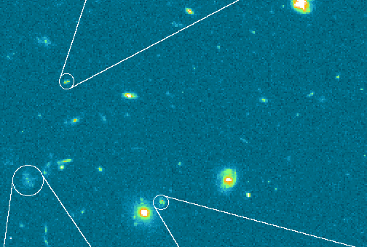
Application:
Combining Low Resolution Sub-Pixel Shifted Images http://www.stecf.org/newsletter/stecf-nl-22/adorf/adorf.html
Hans-Martin Adorf
Problem: Multiple Images of Galazy Clusters with subpixel shifts.

Slide 100
Application:
Combining Low Resolution Sub-Pixel Shifted Images http://www.stecf.org/newsletter/stecf-nl-22/adorf/adorf.html
Hans-Martin Adorf
Problem: Multiple Images of Galazy Clusters with subpixel shifts.
POCS Solution:
Sets of high resolution images giving rise to lower resolution images.
Positivity
Resolution Limit

Slide 101



Application:
Combining Low Resolution Sub-Pixel Shifted Images http://www.stecf.org/newsletter/stecf-nl-22/adorf/adorf.html
Hans-Martin Adorf
2 4
Problem: Multiple Images of Galazy Clusters with subpixel shifts.
POCS Solution:
Sets of high resolution images giving rise to lower resolution images.
Positivity
Resolution Limit

Slide 102

Application:
Subpixel Resolution using the world’s worst camera
Object is imaged with an aperture covering a large area. The average (or sum) of the object is measured as a single number over the aperture.
The set of all images with this average value at this location is a convex set.
The convex set is constant area.

Slide 103

Application:
Subpixel Resolution
Randomly chosen 8x8 pixel blocks. Over 6 Million projections.

Slide 104


Application:
Subpixel Resolution
Slow (7:41) Fast (3:00) Faster (1:30) Fastest (0:56)
Randomly chosen 8x8 pixel blocks. Over 6 Million projections.

Slide 105


Application:
Subpixel Resolution
Slow (0.58) Fast (0:29) Faster (0:14)
Blocks of random dimension <33 chosen at random locations. 2.7 Million blocks.

Slide 106
Outline
POCS: What is it?
  Convex Sets
  Projections
  POCS
Applications
  The Papoulis-Gerchberg Algorithm
  Neural Network Associative Memory
  Resolution at sub-pixel levels
  Radiation Oncology / Tomography
  JPG / MPEG repair
  Missing Sensors
Generalized Alternating Projections
  Ambiguity Function Syntesis
  The Gerchberg-Saxton Algorithm

Slide 107

Application:
Tomography
Same procedure as subpixel resolution.

Slide 108

Application:
Tomography
Same procedure as subpixel resolution.

Slide 109

Application:
Tomography
Same procedure as subpixel resolution.

Slide 110


Tomography
Same procedure as subpixel resolution.
Slow (0.19) Fast (0:09 )
102k iterations in ~log time

Slide 111

Tomography
Same procedure as subpixel resolution.
Slow (0.43) Fast (0:21 )
409k iterations in ~log time

Slide 112

Application:
Radiation Oncology
Conventional Therapy Illustration

Slide 113
Application:
Radiation Oncology
Conventional Therapy Illustration

Slide 114
Application:
Radiation Oncology
Intensity Modulated Radiotherapy

Slide 115
Application:
Radiation Oncology
Convex sets for dosage optimization
C_{N} = Set of beam patterns giving dosage in N less than T_{N.}
C_{C} = Set of beam patterns giving dosage in C less than T_{C} <T_{N.}
C_{T} = Set of beam patterns giving dosage in T between T_{Low} and T_{hi} (no cold spots or hot spots).
C_{C} = Set of nonnegative beam patterns.
N = normal tissue
C = critical organ
T = tumor

Slide 116
Application:
Radiation Oncology
N
T
C
Example POCS Solution

Slide 117

Application:
Radiation Oncology
N
T
C
Example POCS Solution

Slide 118
Application:
Radiation Oncology
N
T
C
Example POCS Solution

Slide 119
Outline
POCS: What is it?
  Convex Sets
  Projections
  POCS
Applications
  The Papoulis-Gerchberg Algorithm
  Neural Network Associative Memory
  Resolution at sub-pixel levels
  Radiation Oncology / Tomography
  JPG / MPEG repair
  Missing Sensors
Generalized Alternating Projections
  Ambiguity Function Syntesis
  The Gerchberg-Saxton Algorithm

Slide 120
Application
Block Loss Recovery Techniques for Image and Video Communications Transmission & Error
During jpg or mpg transmission, some packets may be lost due to bit error, congestion of network, noise burst, or other reasons.
Assumption: No Automatic Retransmission Request (ARQ)

Slide 121

Application
Block Loss Recovery Techniques for Image and Video Communications Transmission & Error
During jpg or mpg transmission, some packets may be lost due to bit error, congestion of network, noise burst, or other reasons.
Assumption: No Automatic Retransmission Request (ARQ)
Missing 8x8 block of pixels

Slide 122
Application
Projections based Block Recovery – Algorithm
Two Steps
  Edge orientation detection
  POCS using Three Convex Sets



Slide 123


Application
Recovery vectors are extracted to restore missing pixels.
Two positions of recovery vectors are possible according to the edge orientation.
Recovery vectors consist of known pixels(white color) and missing pixels(gray color).
The number of recovery vectors, r_{k}, is 2.
Vertical line dominating area
Horizontal line dominating area

Slide 124


Application
Forming a Convex Constraint Using Surrounding Vectors
Surrounding Vectors, s_{k}, are extracted from surrounding area of a missing block by an N x N window.
Each vector has its own spatial and spectral characteristic.
The number of surrounding vectors, s_{k}, is 8N.

Slide 125
Application
Projections based Block Recovery –
Projection operator P₁
Surrounding Blocks
Convex Cone Hull

Slide 126
Application
Projection operator P₁
r
P₁ r
Convex Cone Hull

Slide 127


Application
Projection operator P₂
_{Identical Middles}
Keep This Part
P₁
Replace this part with the known image

Slide 128

Application
Projection operator P₃
_{Smoothness Constraint}
Convex set C₃ acts as a convex constraint between missing pixels and adjacent known pixels, (f_{N-1} f_{N}). The rms difference between the columns is constrained to lie below a threshold.
f_{N-1} f_{N}

Slide 129
Application
Simulation Results – Test Data and Error
Peak Signal to Noise Ratio

Slide 130

Simulation Results –
Lena, 8 x 8 block loss
Original Image
Test Image

Slide 131


Simulation Results –
Lena, 8 x 8 block loss
Ancis, PSNR = 28.68 dB
Hemami, PSNR = 31.86 dB

Slide 132


Simulation Results –
Lena, 8 x 8 block loss
Ziad, PSNR = 31.57 dB
POCS, PSNR = 34.65 dB

Slide 133




Simulation Results –
Lena, 8 x 8 block loss
Ancis
PSNR = 28.68 dB
Hemami
PSNR = 31.86 dB
Ziad
PSNR = 31.57 dB
POCS
PSNR = 34.65 dB

Slide 134

Simulation Results – Each Step
Lena 8 x 8 block loss
(a)
(b)
(c)

Slide 135


Simulation Results –
Peppers, 8 x 8 block loss
Original Image
Test Image

Slide 136


Simulation Results –
Peppers, 8 x 8 block loss
Ancis, PSNR = 27.92 dB
Hemami, PSNR = 31.83 dB

Slide 137


Simulation Results –
Peppers, 8 x 8 block loss
Ziad, PSNR = 32.76 dB
POCS, PSNR = 34.20 dB

Slide 138
Simulation Results – PSNR (8 x 8)
 | Lena | Masqrd | Peppers | Boat | Elaine | Couple
Ancis | 28.68 | 25.47 | 27.92 | 26.33 | 29.84 | 28.24
Sun | 29.99 | 27.25 | 29.97 | 27.36 | 30.95 | 28.45
Park | 31.26 | 27.91 | 31.71 | 28.77 | 32.96 | 30.04
Hemami | 31.86 | 27.65 | 31.83 | 29.36 | 32.07 | 30.31
Ziad | 31.57 | 27.94 | 32.76 | 30.11 | 31.92 | 30.99
POCS | 34.65 | 29.87 | 34.20 | 30.78 | 34.63 | 31.49

Slide 139


Simulation Results –
Masquerade, 8 x one row block loss
Original Image
Test Image

Slide 140


Simulation Results –
Masquerade, 8 x one row block loss
Hemami, PSNR = 23.10 dB
POCS, PSNR = 25.09 dB

Slide 141



Interpolation based Coding – Result 1
JPEG Coding
PSNR = 32.27 dB
Size = 0.30 BPP = 9,902 Byte
w/ Removed Blocks
Blocks : 447 / 4096 = 11%
Size = 0.29 BPP
I-based Coding
PSNR = 32.35 dB
Size = 0.29 BPP = 9,634 Byte

Slide 142


Interpolation based Coding – Result 2
JPEG Coding
PSNR = 32.27 dB
Size = 0.30 BPP = 9,902 Byte
w/ Removed Blocks
Blocks : 557 / 4096 = 14%
Size = 0.27 BPP
I-based Coding
PSNR = 32.37 dB
Size = 0.27 BPP = 9,570 Byte

Slide 143
Temporal Block Loss Recovery
In video coding (e, g, MPEG), temporal recovery is more effective.
t-1
t

Slide 144

Simulation Results – Flower Garden
Original Sequence
Test Sequence

Slide 145
Simulation Results – Flower Garden
Zero Motion Vector, PSNR = 16.15 dB
Average of Surrounding Motion Vectors, PSNR = 18.64 dB

Slide 146
Simulation Results – Flower Garden
Motion Flow Interpolation (1999), PSNR = 19.29 dB
Boundary Matching Algorithm (1993), PSNR = 19.83 dB

Slide 147
Simulation Results – Flower Garden
Decoder Motion Vector Estimation (2000), PSNR = 19.21 dB
POCS Based, PSNR = 20.71 dB

Slide 148

Simulation Results – Foreman
Original Sequence
Test Sequence
Zero Motion Vector PSNR = 24.71 dB
Average of Surrounding Motion Vectors PSNR = 26.22 dB

Slide 149
Simulation Results – Foreman
Motion Flow Interpolation (1999) PSNR = 27.09 dB
Boundary Matching Algorithm (1993), PSNR = 28.76 dB
Decoder Motion Vector Estimation (2000), PSNR = 27.46 dB
POCS Based PSNR = 29.82 dB

Slide 150
Simulation Results – Average PSNR
 | Garden | Tennis | Football | Mobile | Foreman
MV | 16.15 | 22.40 | 18.06 | 17.49 | 24.71
AV | 18.64 | 21.98 | 18.72 | 19.03 | 26.22
BMA | 19.83 | 23.55 | 19.41 | 19.75 | 28.76
DMVE | 19.88 | 24.04 | 19.64 | 20.02 | 28.77
MFI | 19.29 | 22.77 | 19.29 | 19.60 | 27.09
F-B BM | 19.21 | 22.49 | 19.05 | 19.59 | 27.46
Proposed | 20.71 | 24.52 | 20.32 | 20.66 | 29.82

Slide 151
Outline
POCS: What is it?
  Convex Sets
  Projections
  POCS
Applications
  The Papoulis-Gerchberg Algorithm
  Neural Network Associative Memory
  Resolution at sub-pixel levels
  Radiation Oncology / Tomography
  JPG / MPEG repair
  Missing Sensors
Generalized Alternating Projections
  Ambiguity Function Synthesis
  The Gerchberg-Saxton Algorithm

Slide 152
Application
Missing Sensors
Idea:
A collection of spatially distributed point sensors.
Their readings are interrelated (e.g. temperature sensors in a room).

Slide 153
Application
Missing Sensors
A plurality of sensors fail.
Can the failed sensor readings be regained from those remaining without use of models?
Applications: (1) Power Security Assessment (2) Engine Vibration Sensors
X
X
X
X
X

Slide 154
Application
Missing Sensors
Step 1: Learn the interrelationship among the sensors by training an auto-encoder neural network with historical data.
The mapping of a properly trained neural network is a projection.

Slide 155
Application
Missing Sensors
Step 2: Impose the second convex constraint of known sensor values. If POCS, convergence is assured
ignore
ignore
g

Slide 156

Application
Missing Sensors
Example: Vibration Sensors on a Jet Engine
x direction y direction z direction

Slide 157

Application
Missing Sensors
Four Sensors – One Missing
Original Sensor Data
Reconstructed sensor data when sensor 4 fails.
known
restored

Slide 158

Application
Missing Sensors
Four Sensors – Two Missing
ail
known
missing
Figure 5: Restoration of two lost vibration sensors corresponding to 44 points of data. The real

Slide 159

Application
Missing Sensors
Eight Sensors – Two Missing
(Magnitude Only)
ail
Reconstructed sensor data when sensors seven and eight fail.
known
missing
Reconstruction Error
Figure 5: Restoration of two lost vibration sensors corresponding to 44 points of data. The real

Slide 160
Outline
POCS: What is it?
  Convex Sets
  Projections
  POCS
Applications
  The Papoulis-Gerchberg Algorithm
  Neural Network Associative Memory
  Resolution at sub-pixel levels
  Radiation Oncology / Tomography
  JPG / MPEG repair
  Missing Sensors
Generalized Alternating Projections
  Ambiguity Function Synthesis
  The Gerchberg-Saxton Algorithm

Slide 161


Ambiguity Function Signal Synthesis
Woodward’s Ambiguity Function
$$χ\left(τ, u\right)=\int_{t}^{ }{x\left(t\right)x^{∗}\left(t−τ\right)e^{−j2πut}dt}$$
There exists an inherent trade-off in
the ability of a signal to accurately measure both the range ($determined by delay τ$) and
velocity (measured from Doppler shift $u$) of a target. Woodward’s ambiguity function measures
this uncertainty for narrowband RF signals for monostatic radar
Ambiguity Function of a rectangle

Slide 162
Ambiguity Function Signal Synthesis
Synthesized Signal Constraints:
Limited Peak-to-average-power ratio (PAPR)
Spectral mask constraint
Targeted ambiguity function
Spectral mask constraint
Ambiguity function constraint

Slide 163





Ambiguity Function Signal Synthesis
$$χ\left(τ, u\right)=\int_{t}^{ }{x\left(t\right)x^{∗}\left(t−τ\right)e^{−j2πut}dt}$$
$$χ\left(τ, u\right)=\int_{t}^{ }{x\left(t\right)x^{∗}\left(t−τ\right)e^{−j2πut}dt}$$
$$χ\left(τ, u\right)=\int_{t}^{ }{x\left(t\right)x^{∗}\left(t−τ\right)e^{−j2πut}dt}$$
$$χ\left(τ, u\right)=\int_{t}^{ }{x\left(t\right)x^{∗}\left(t−τ\right)e^{−j2πut}dt}$$
$$χ\left(τ, u\right)=\int_{t}^{ }{x\left(t\right)x^{∗}\left(t−τ\right)e^{−j2πut}dt}$$
Dylan Eustice, Charles Baylis and Robert J. Marks II, "Woodward’s Ambiguity Function: From Foundations to Applications,'' 2015 IEEE Texas Symposium on Wireless and Microwave Circuits and Systems (WMCS), April 23-24, 2015. Waco, Texas (pp. 1-17). DOI: 10.1109/WMCaS.2015.7233208
Dylan Eustice, Charles Baylis, Lawrence Cohen, and Robert J. Marks II. "Waveform synthesis via alternating projections with ambiguity function, peak-to-average power ratio, and spectrum requirements." 2016 IEEE Radio and Wireless Symposium (RWS), pp. 190-192. IEEE, 2016. DOI: 10.1109/RWS.2016.7444401

Slide 164
Outline
POCS: What is it?
  Convex Sets
  Projections
  POCS
Applications
  The Papoulis-Gerchberg Algorithm
  Neural Network Associative Memory
  Resolution at sub-pixel levels
  Radiation Oncology / Tomography
  JPG / MPEG repair
  Missing Sensors
Generalized Alternating Projections
  Ambiguity Function Synthesis
  The Gerchberg-Saxton Algorithm

Slide 165









Gerchberg-Saxton Algorithm
$$t_{2}$$
$$u_{2}$$
$$x(t_{1},t_{2})$$
$$t_{1}$$
$$\sim X(u_{1},u_{2})$$
$$u_{1}$$
Fraunhofer (far field) diffraction
$$x\left(t_{1},t_{2}\right)=\left|x\right|e^{j∠x}$$
$$ℱ$$
$$X\left(u_{1},u_{2}\right)=\left|X\right|e^{j∠X}$$

Slide 166
Gerchberg-Saxton Algorithm
$$t_{2}$$
$$u_{2}$$
$$x(t_{1},t_{2})$$
$$t_{1}$$
$$\sim X(u_{1},u_{2})$$
$$u_{1}$$
Fraunhofer (far field) diffraction
$$x\left(t_{1},t_{2}\right)=\left|x\right|e^{j∠x}$$
$$ℱ$$
$$X\left(u_{1},u_{2}\right)=\left|X\right|e^{j∠X}$$
Square Law Detector measures $\left|x\right|$ and $\left|X\right|$.
Problem: Given $\left|x\right|$ and $\left|X\right|$, find phase $∠x$ and $∠X$

Slide 167


Gerchberg-Saxton Algorithm
$$t_{2}$$
$$u_{2}$$
$$x(t_{1},t_{2})$$
$$t_{1}$$
$$\sim X(u_{1},u_{2})$$
$$u_{1}$$
Fraunhofer (far field) diffraction
$$x\left(t_{1},t_{2}\right)=\left|x\right|e^{j∠x}$$
$$ℱ$$
$$X\left(u_{1},u_{2}\right)=\left|X\right|e^{j∠X}$$
Square Law Detector measures $\left|x\right|$ and $\left|X\right|$.
Problem: Given $\left|x\right|$ and $\left|X\right|$, find phase $∠x$ and $∠X$
Note: $C=\left\{y \left| \left|y\right|=|x|\right.\right\}$ is not convex
But we can impose an idempotent projection: keep the phase and impose the magnitude: $℘_{C}\left[y\right]=\left|x\right|e^{j∠y}$

Slide 168














Gerchberg-Saxton Algorithm
$$t_{2}$$
$$u_{2}$$
$$x(t_{1},t_{2})$$
$$X(u_{1},u_{2})$$
$$ℱ$$
$$t_{1}$$
$$u_{1}$$
Iterative Restoration:
$$g_{n}=\left|x \right|e^{j∠f_{n}}$$
$$ℱ$$
$$G_{n}=\left|G_{n−1} \right|e^{j∠G_{n}}$$
$$n=n+1$$
Iteratively impose magnitude in both domains
$$f_{n}=\left|f_{n} \right|e^{j∠f_{n}}$$
$$ℱ^{−1}$$
$$F_{n}=\left|X\right|e^{j∠G_{n}}$$

Slide 169









Gerchberg-Saxton Algorithm
Example: Sad to Happy
$$t_{2}$$
$$u_{1}$$
$$t_{1}$$
$$u_{2}$$
$$ℱ$$
$$\left|x(t_{1},t_{2}) \right|$$
$$\left|X(u_{1},u_{2}) \right|$$

Slide 170
Gerchberg-Saxton Algorithm

Slide 171
Gerchberg-Saxton Algorithm

Slide 172

Final Comments
POCS: What is it?
  Convex Sets
  Projections
  POCS
Applications
  The Papoulis-Gerchberg Algorithm
  Neural Network Associative Memory
  Resolution at sub-pixel levels
  Radiation Oncology / Tomography
  JPG / MPEG repair
  Missing Sensors
Generalized Alternating Projections
  Ambiguity Function Synthesis
  The Gerchberg-Saxton Algorithm
R.J. Marks II, Handbook of Fourier Analysis and Its Applications, Oxford University Press, (2009).
http://robertmarks.org/REPRINTS/Marks-Pubs.htm

Slide 173
Finis
Finis
Finis
Finis
Finis
Finis

