Slide 1
Introduction to Fuzzy Inference
Robert J. Marks II
Baylor University

Slide 2

Controversy
“The image which is portrayed is of the ability to perform
magically well by the incorporation of `new age’ technologies
Professor Bob Bitmead,
IEEE Control Systems Magazine,
June 1993, p.7.
<bob@syseng.anu.edu.au>
< http://keating.anu.edu.au/~bob/>
of fuzzy logic, neural networks,
... approximate reasoning, and
self-organization in the face of
dismal failure of traditional
methods. This is pure unsupported
claptrap which is pretentious
and idolatrous in the extreme,
and has no place in scientific
literature.”

Slide 3
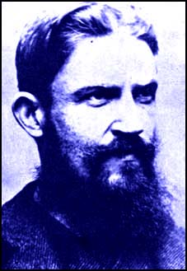
The Wisdom of Experience ... ???
“(Fuzzy theory’s) delayed exploitation outside Japan teaches several lessons. ...(One is) the traditional intellectualism in engineering research in general and the cult of analyticity within control system engineering research in particular.”
  E.H. Mamdami, 1975 father of fuzzy control (1993).
"All progress means war with society."
George Bernard Shaw

Slide 4
Crisp Versus Fuzzy
Conventional or crisp sets are binary. An element either belongs to the set or doesn't.
Fuzzy sets, on the other hand, have grades of memberships. The set of cities `far' from Los Angeles is an example.

Slide 5


Fuzzy Linguistic Variables
The term far used to define this set is a fuzzy linguistic variable.
Other examples include close, heavy, light, big, small, smart, fast, slow, hot, cold, tall and short.
e.g. On a scale of one to 10, how good was the dive?
10
9
9
9.5

Slide 6
Continuous Fuzzy Membership Functions
The set, B, of numbers near to two is
or...
μ_{B}(x)
0 1 2 3 x

Slide 7
Fuzzy Subsets
A fuzzy set, A, is said to be a subset of B if
e.g. B = far and A=very far.
For example...

Slide 8
Crisp Membership Functions
Crisp membership functions are either one or zero.
e.g. Numbers greater than 10.
A ={x | x>10}
μ_{A}(x)
1
x
10

Slide 9
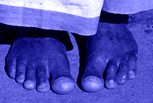

Fuzzy Versus Probability
Fuzzy ≠ Probability
Example #1
  Billy has ten toes. The probability Billy has nine toes is zero. The fuzzy membership of Billy in the set of people with nine toes, however, is nonzero.

Slide 10
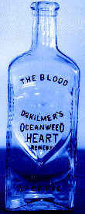
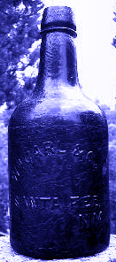
Fuzzy Versus Probability
Example #2
  A bottle of liquid has a probability of ½ of being rat poison and ½ of being pure water.
  A second bottle’s contents, in the fuzzy set of liquids containing lots of rat poison, is ½.
  The meaning of ½ for the two bottles clearly differs significantly and would impact your choice should you be dying of thirst.
  (cite: Bezdek)
#1
#2

Slide 11
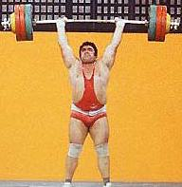
Fuzzy Versus Probability
Example #3
  Fuzzy is said to measure “possibility” rather than “probability”.
  Difference
    All things possible are not probable.
    All things probable are possible.
  Contrapositive
    All things impossible are improbable
    Not all things improbable are impossible

Slide 12

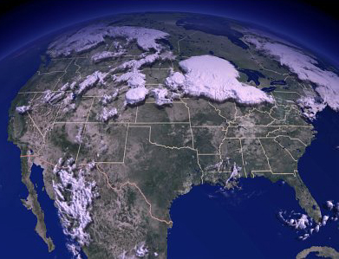
Fuzzy Vs. Crisp Probability
The probability that a fair die will show six is 1/6. This is a crisp probability. All credible mathematicians will agree on this exact number.
The weatherman's forecast of a probability of rain tomorrow being 70% is also a fuzzy probability. Using the same meteorological data, another weatherman will typically announce a different probability.

Slide 13

Fuzzy Logic
Criteria for fuzzy “and”, “or”, and “complement”
Must meet crisp boundary conditions
Commutative
Associative
Idempotent
Monotonic

Slide 14
Fuzzy Logic
Example Fuzzy Sets to Aggregate...
A = { x | x is near an integer}
B = { x | x is close to 2}
μ_{A}(x)
μ_{B}(x)
1
0 1 2 3 x
0 1 2 3 x

Slide 15

Fuzzy Union
Fuzzy Union (logic “or”)
Meets crisp boundary conditions
Commutative
Associative
Idempotent
Monotonic

Slide 16
Fuzzy Union
A OR B = A+B ={ x | (x is near an integer) OR (x is close to 2)}
= MAX [μ_{A}(x), μ_{B}(x)]
μ_{A+B} (x)
0 1 2 3 x

Slide 17
Fuzzy Intersection
Fuzzy Intersection (logic “and”)
Meets crisp boundary conditions
Commutative
Associative
Idempotent
Monotonic

Slide 18
Fuzzy Intersection
A AND B = A·B ={ x | (x is near an integer) AND (x is close to 2)}
= MIN [μ_{A}(x), μ_{B}(x)]
μ_{A⋅B}(x)
0 1 2 3 x

Slide 19
Fuzzy Complement
The complement of a fuzzy set has a membership function...
complement of A ={ x | x is not near an integer}
1
0 1 2 3 x

Slide 20
Associativity
Min-Max fuzzy logic has intersection distributive over union...
since
min[ A,max(B,C) ]=min[ max(A,B), max(A,C) ]

Slide 21
Associativity
Min-Max fuzzy logic has union distributive over intersection...
since
max[ A,min(B,C) ]= max[ min(A,B), min(A,C) ]

Slide 22
DeMorgan's Laws
Min-Max fuzzy logic obeys DeMorgans Law #1...
since
1 - min(B,C)= max[ (1-A), (1-B)]

Slide 23
DeMorgan's Laws
Min-Max fuzzy logic obeys DeMorgans Law #2...
since
1 - max(B,C)= min[(1-A), (1-B)]

Slide 24
Excluded Middle
Min-Max fuzzy logic fails The Law of Excluded Middle.
since
min(μ _{A},1-μ _{A}) ≠ 0
Thus, (the set of numbers close to 2) AND (the set of numbers not close to 2) ≠ null set

Slide 25
Contradiction
Min-Max fuzzy logic fails the The Law of Contradiction.
since
max(μ _{A},1-μ _{A}) ≠ 1
Thus, (the set of numbers close to 2) OR (the set of numbers not close to 2) ≠ universal set

Slide 26
Other Fuzzy Logics
There are numerous other operations OTHER than Min and Max for performing fuzzy logic intersection and union operations.
A common set operations is sum-product inferencing, where…

Slide 27
Cartesian Product
The intersection and union operations can also be used to assign memberships on the Cartesian product of two sets.
Consider, as an example, the fuzzy membership of a set, G, of liquids that taste good and the set, LA, of cities close to Los Angeles

Slide 28
Cartesian Product
We form the set...
E = G ·LA
= liquids that taste good AND cities that
are close to LA
The following table results...
LosAngeles(0.0) Chicago (0.5) New York (0.8) London(0.9)
Swamp Water (0.0) 0.00 0.00 0.00 0.00
Radish Juice (0.5) 0.00 0.25 0.40 0.45
Grape Juice (0.9) 0.00 0.45 0.72 0.81

Slide 29
Fuzzy
Inference
Crisp input
Fuzzification
“antecedent”
Rules
“consequent”
Defuzzification
Crisp Output Result

Slide 30

Fuzzy Inference Example
Example #2
  Assume that we need to evaluate student applicants based on their GPA and GRE scores.
  For simplicity, let us have three categories for each score [High (H), Medium (M), and Low(L)]
  Let us assume that the decision should be Excellent (E), Very Good (VG), Good (G), Fair (F) or Poor (P)
  An expert will associate the decisions to the GPA and GRE score.

Slide 31
Fuzzy Rule Table
GRE
H
M
L
E
VG
F
H
GPA
G
G
B
M
L
F
B
B

Slide 32
Fuzzification
A Fuzzifier converts a crisp input into a vector of fuzzy membership values.
The membership functions
reflects the designer's knowledge
provides smooth transition between fuzzy sets
are simple to calculate
Typical shapes of the membership function are Gaussian, trapezoidal and triangular.

Slide 33

Membership Functions for GRE
μ_{GRE}
Low
Medium
High
1
800
1200
1800
GRE
μ_{GRE} = {μ_{L} , μ_{M} , μ_{H} }

Slide 34
Membership Functions for the GPA
μ_{GPA}
Low
Medium
High
1
2.2
3.0
3.8
GPA
μ_{GPA} = {μ_{L} , μ_{M} , μ_{H} }

Slide 35
Membership Function for the Consequent
F
B
F
G
VG
1
60
70
80
90
100
Decision

Slide 36
Fuzzification
Transform the crisp antecedents into a vector of fuzzy membership values.
Assume a student with GRE=900 and GPA=3.6. Examining the membership function gives
μ_{GRE} = {μ_{L} = 0.8 , μ_{M} = 0.2 , μ_{H} = 0}
μ_{GPA} = {μ_{L} = 0 , μ_{M} = 0.6 , μ_{H} = 0.4}

Slide 37
Activated Rules
GRE
H
M
L
E
VG
F
H
GPA
G
G
B
M
L
F
B
B

Slide 38
Memberships of Activated Rules
GRE
0
0.2
0.8
0.4
0
0.2
0.4
GPA
0.6
0
0.2
0.6
0
0
0
0
F = {B,F,G,VG,E}
F = {0.6, 0.4, 0.2, 0.2, 0}

Slide 39
Weight Consequent Memberships
F
1
B
F
G
VG
60
70
80
90
100
Decision

Slide 40
Defuzzification
Converts the output fuzzy numbers into a unique (crisp) number
Method: Add all weighted curves and find the center
F
1
B
F
G
VG
60
80
90
100
Decision=Fair Student

Slide 41
Max Method
Fuzzy set with the largest membership value is selected.
Fuzzy decision: F = {B, F, G,VG, E}
F = {0.6, 0.4, 0.2, 0.2, 0}
Final Decision (FD) = Bad Student
If two decisions have same membership max, use the average of the two.

Slide 42
Decision: Max Method
F
1
B
F
G
VG
70
80
90
100
Decision

Slide 43
Example: Fuzzy Table for Control
CE
LN
MN
SN
ZE
SP
MP
LP
LN
LN
LN
LN
LN
MN
SN
SN
MN
LN
LN
LN
MN
SN
ZE
ZE
SN
LN
LN
MN
SN
ZE
ZE
SP
E
ZE
LN
MN
SN
ZE
SP
MP
LP
SP
SN
ZE
ZE
SP
MP
LP
LP
MP
ZE
ZE
SP
MP
LP
LP
LP
LP
SP
SP
MP
LP
LP
LP
LP

Slide 44
Membership Functions
m
LN
MN
SN
ZE
SP
MP
LP
1
E
CU
0
-6
-3
-1
0
1
3
6
m
LN
MN
SN
ZE
SP
MP
LP
1
CE
0
-3
-2
-1
0
1
2
3

Slide 45
Rule Aggregation
CE
LN
MN
SN
ZE
SP
MP
LP
LN
LN
LN
LN
LN
MN
e. SN
0.2
f. SN
0.0
MN
LN
LN
LN
MN
d. SN
0.5
ZE
ZE
SN
LN
LN
MN
c.SN
0.3
ZE
ZE
SP
E
ZE
LN
MN
b.SN
0.4
ZE
SP
MP
LP
SP
a. SN
0.1
ZE
ZE
SP
MP
LP
LP
MP
ZE
SP
SP
MP
LP
LP
LP
LP
SP
SP
MP
LP
LP
LP
LP
Consequent is or SN if a or b or c or d or f.

Slide 46
Rule Aggregation
Consequent is or SN if a or b or c or d or f.
Consequent Membership = max(a,b,c,d,e,f) = 0.5
More generally:

Slide 47
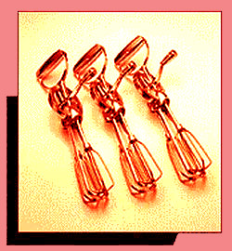
Rule Aggregation
Special Cases:

Slide 48
Lab Test: Speed Tracking of IM
1800
900
trajectory
response
rpm
0
-900
-1800
0
3
6
9
12
15
18
21
24
27
Time [sec]

Slide 49
Lab Test: Prercision Position Tracking of IM
5
4
Turn
3
trajectory
2
response
1
0
0
3
6
9
12
15
18
21
24
27
Time [sec]

Slide 50
Commonly Used Variations
Clipped vs. Weighted Defuzzification
F
1
B
F
G
VG
60
80
90
100
F
1
B
F
G
VG
60
80
90
100

Slide 51
Commonly Used Variations
Sum-Product Inferencing
Instead of min(x,y) for fuzzy AND...
Use ⇒ x • y
Instead of max(x,y) for fuzzy OR...
Use ⇒ min(1, x + y)
Why?

Slide 52
Commonly Used Variations
Sugeno inferencing
Other Norms and co-norms
Relationship with Neural Networks
Explanation Facilities
Teaching a Fuzzy System
Tuning a Fuzzy System

Slide 53
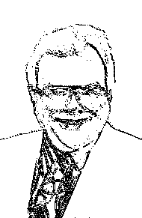
The Bottom Line...
Reduction
to
Practice
“In theory, theory and reality are the same.
In reality, they are not.”

Slide 54
Finis

