Slide 1
God Ever Geometrizes: Apologetics in Mathematics
Aεὶ ὁ θεὸς γεωμετρεῖ
Robert J. Marks II
….the structure of the universe reveals the mind of a "pure mathematician", the Great Architect of the Universe.
Notes:
“God Ever Geometrizes” Plato
What is the role of apologetics?

Slide 2
Abstract: Heinrich Hertz (1857–1894) said “One cannot escape the feeling that … mathematical formulas have an independent existence and an intelligence of their own, that they are wiser than we are, wiser even than their discoverers, that we get more out of them than was originally put into them.” There are numerous instantiations of Hertz’s observation. We will discuss why Georg Cantor (1845-1918) took his work in transfinite numbers to the Vatican. How did Karl Friedrich Gauss (1777–1855) believe God was involved in his mathematics? How did Blaise Pascal (1623-1662) use set theory and probability to argue for God’s existence? What numbers did Gottfried Wilhelm Leibniz (1646–1716) say are the “fine and wonderful recourse of the divine spirit, almost an amphibian between being and not being.” How did Kurt Gödel (1906–1978) mathematically prove Anselm’s ontological argument for God’s existence? How did an 19th century schoolmaster generalize existence to higher dimensions and offer explanations of Biblical miracles? How does Gregory Chaitin (1947- ) mathematically prove there are astonishing things that exist that are unknowable? And how does Rice’s Theorem shed light on a consistency between determinism and knowability? Stephen Hawking (1942- ) claims no theory in science can be proven. We simply accumulate evidence. Like all apologetics, these insights of mathematics do not prove God’s existence nor Christianity. But they add to the accumulation of evidence about the reality of Judeo-Christian God. This talk, although accessible by those not well versed in mathematics, provides references for deeper study by those who are.
Notes:
Abstract

Slide 3
God Ever Geometrizes: Apologetics in Mathematics
Contents

Apologetics, Provability and God Math
Mathematics is Spooky
Flatland Miracles
To ∞ and Beyond !
The Gödel Effect & the Unknowable

Slide 4
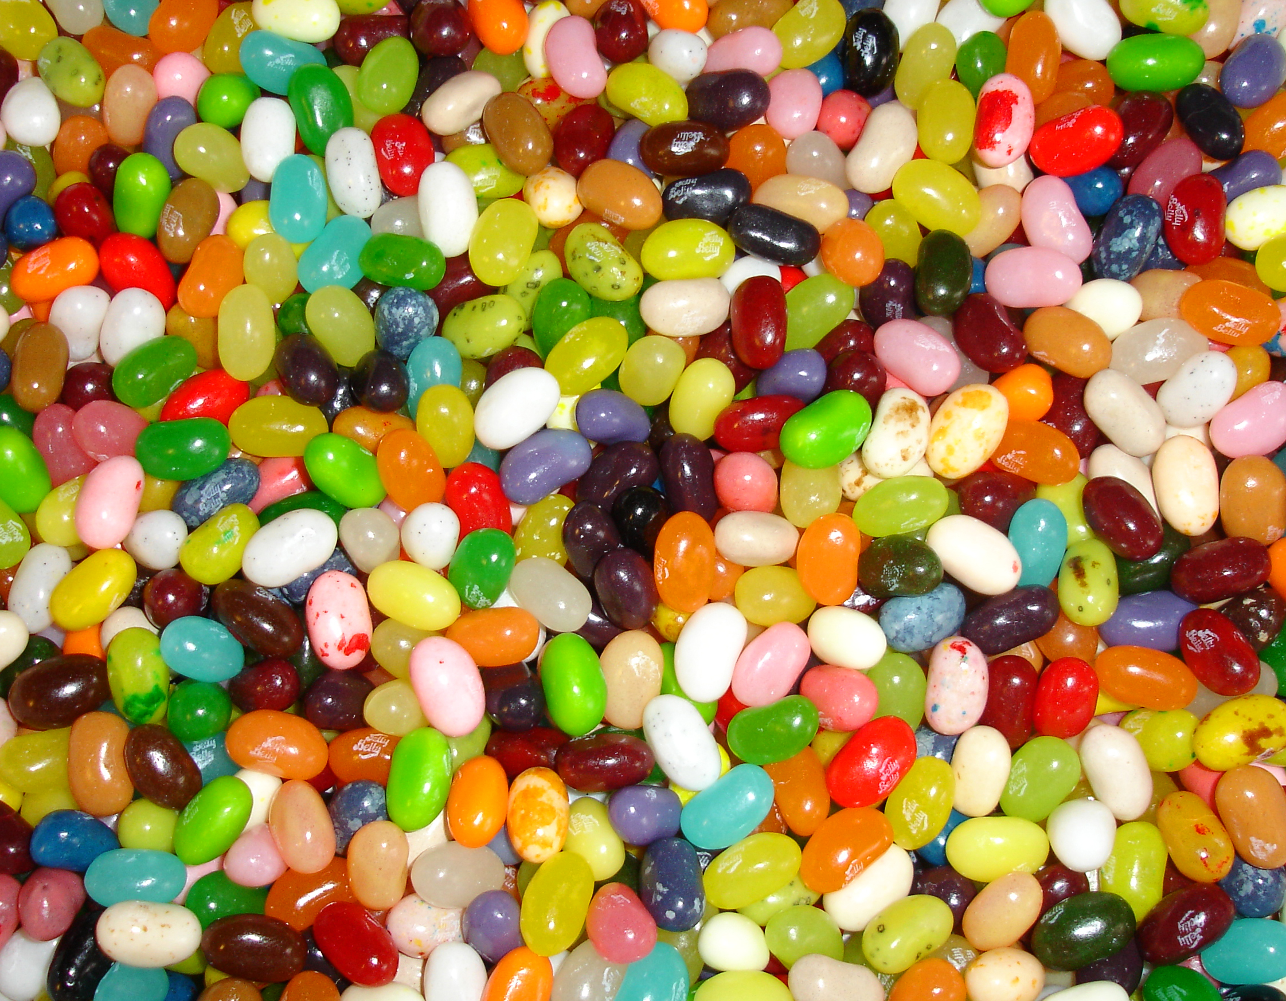
APOLOGETICS
for nerds
Notes:
Apologetics comes in many flavors: historical and legal evidentialist apologetics, presuppositional apologetics, philosophical apologetics, prophetic apologetics, doctrinal apologetics, biblical apologetics, moral apologetics, and scientific apologetics.
Purpose: (1) Removal of uninformed barriers.
(2) Conformation of faith by accumulation of barriers.
Apologetics for nerds also includes physics and ID. It is the revelation of God in His creation.
“The more I study nature, the more I stand amazed at the work of the Creator. Into his tiniest creatures, God has placed extraordinary properties ...”
Louis Pasteur (1822-1895)
“God is going to to reveal to us things He never revealed before if we put our hands in His.”
George Washington Carver (1865-1943)
(who named his laboratory God’s Little Workshop.)

Slide 5

“For the invisible things of him from the creation of the world are clearly seen, being understood by the things that are made, [even] his eternal power and Godhead; so that they are without excuse.” Romans 1:20 (KJV)
Notes:
Evidence of God is in his creation.
Can we prove God by apologetics?

Slide 6
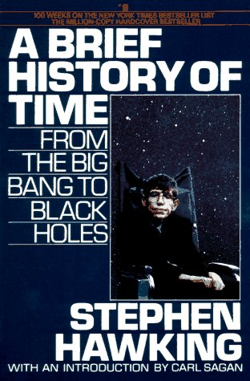
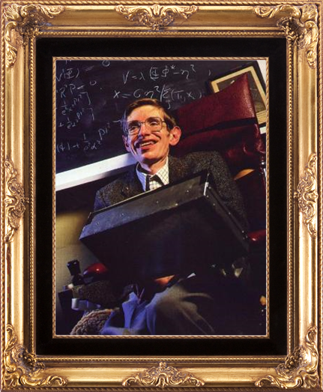
Stephen Hawking
Scientific Models Cannot be “Proved”
Notes:
Scientific models cannot be proven. We only accumulate evidence.
But we must be careful. Contradictory evidence does not necessarily invalidate (or falsify) theory.
1. For example, gravity.
M theory says gravity is weaker in higher dimensions. If true, this does not invalidate our model.
2. In the same sense, relativity and quantum mechanics do not invalidate Newtonian physics.
3. Contradictory evidence is often resolved at higher levels. John Polkinghorne gives the example of light as a particle or a wave.

Slide 7
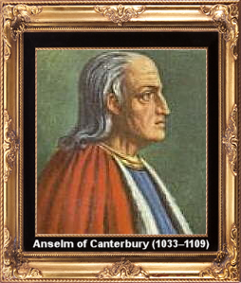
“PROOFS” of God:
Anselm’s ontological Argument
In Understanding
The Tooth Fairy
Harry Potter
Don Quixote
Sarah Palin
Sam Chen
GOD
Momar Ghadaffi
Undiscovered Galaxies
Unknown Species
The Next Great Invention
In Reality
Notes:
(1) Suppose that God exists in the understanding alone.
(2) Thus, a being than which none greater can be conceived exists in the understanding alone.
(3) But this being can be conceived to exist in reality. That is, we can conceive of a circumstance in which theism is true, even if we do not believe that it actually obtains.
(4) But it is greater for a thing to exist in reality than for it to exist in the understanding alone.
(5) Hence we are forced to conclude that a being than which none greater can be conceived can be conceived to be greater than it is.
(6) But that is absurd.
(7) So the supposition that God exists totally in the understanding must be false. God must exist in reality as well as in the understanding.

Slide 8
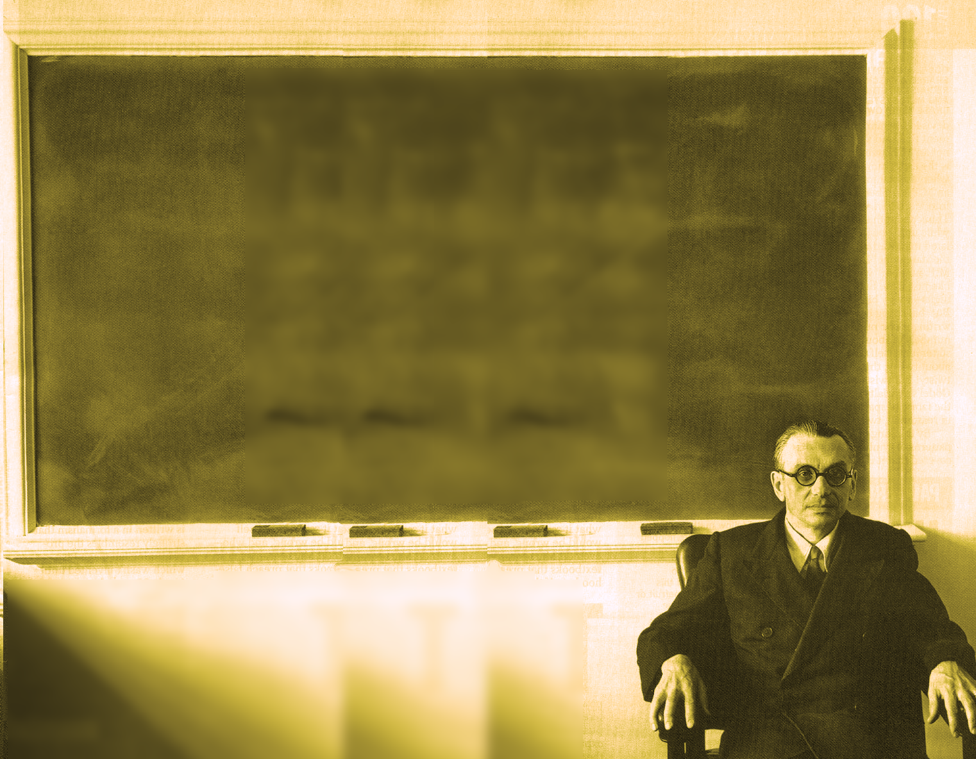
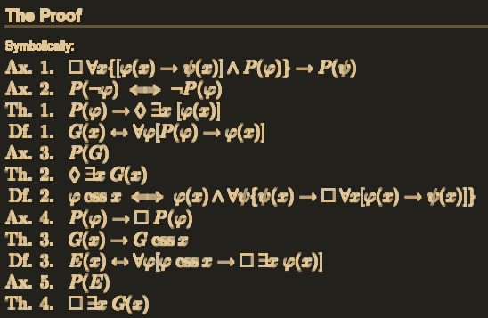
Gödel’s Proof of God Using Anselm’s Ontological Argument
Notes:
http://en.wikipedia.org/wiki/G%C3%B6del's_ontological_proof

Slide 9
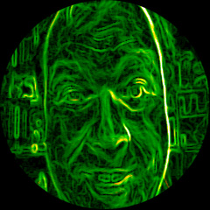
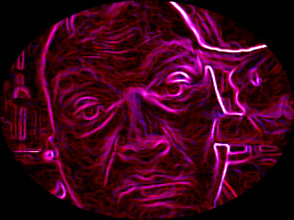
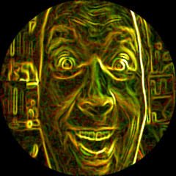
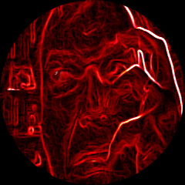
Pascal’s Wager: A Venn Diagram
Notes:
“How can anyone lose who chooses to become a Christian? If, when he dies, there turns out to be no God and his faith was in vain, he has lost nothing - in fact, he has been happier in life than his nonbelieving friends. If, however, there is a God and a heaven and hell, then he has gained heaven and his skeptical friends will have lost everything in hell!”
Henry H. Morris, Men of Science-Men of God (El Cajon, CA: Master Books, A Division of Creation Life Publishers, Inc., 1988), pp. 15-16.

Slide 10
God Ever Geometrizes: Apologetics in Mathematics
Contents

Apologetics, Provability and God Math
Mathematics is Spooky
Flatland Miracles
To ∞ and Beyond !
The Gödel Effect & the Unknowable
Notes:
Does man create math? Or is the math there and we discover it?
I think the former.
Contrast: Determinism versus Free will. If I dig a hole, is it a creation? Or was it already there and I just took the dirt out?

Slide 11
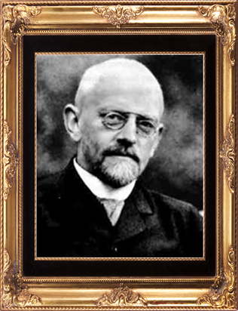

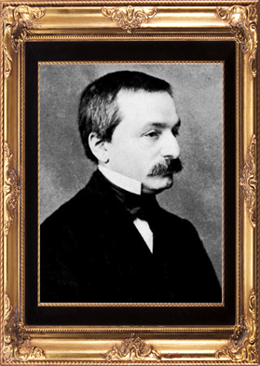
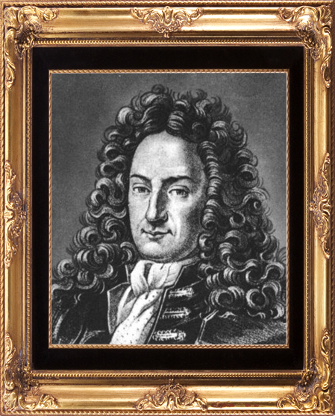
In Theory, Theory and Reality are the Same
Infinity?
2. Irrational Numbers?
3. Imaginary numbers?
David Hilbert
Gottfried Wilhelm
Leibniz
4. Integers?
Leopold Kronecker
Notes:
In Theory, Theory and Reality are the Same
In Reality, they are not.
Here is some math that may or may not exist.
“…the infinite is nowhere to be found in reality” David Hilbert
“The imaginary number is a fine and wonderful recourse of the divine spirit, almost an amphibian between being and not being.” Gottfried Wilhelm Leibniz
"God made the integers; all else is the work of man" Leopold Kronecker

Slide 12
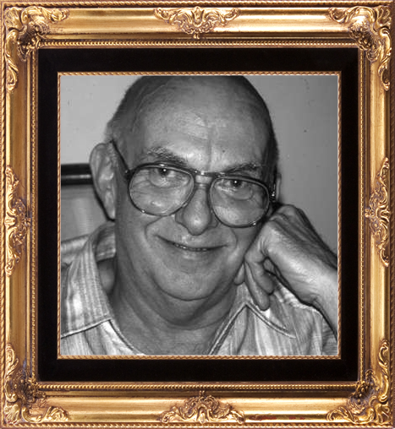
In Theory, Theory and Reality are the Same
David Slepianß
“the miracle of modern scence”
Notes:
It is spooky that math applies to reality. “To the extent that there is some correspondence between [the natural world and its mathematical modeling] … we have the miracle of modem science - the deepening understanding of our universe, and the bounty and ease of the technological society in which we live. A second-order miracle, little recognized or appreciated, is that this first miracle could arise from such a really ragged fit between the [natural world and its mathematical modeling].
David Slepian. Bell Labs

Slide 13
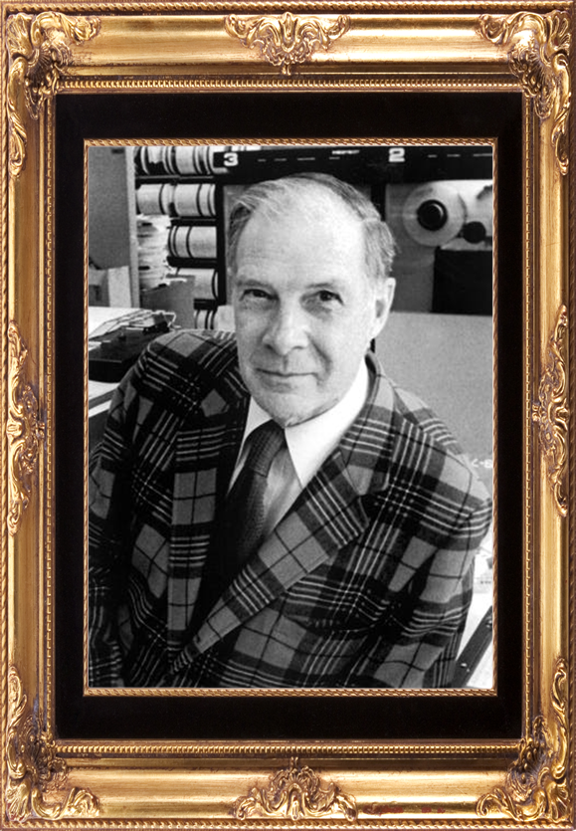
Numbed By
Familiarity?
Richard W.
Hamming
“The Unreasonable Effectiveness of Mathematics”
Notes:
Are we numbed by familiarity?
Richard Hamming finds counting numbers spooky.
Richard W. Hamming (1915-1998) Computer Scientist and Mathematician
Hamming Windows, Hamming Distance, Hamming Error Correcting Codes, Founder of Association for Computing Machinery (AMS), IEEE Richard Hamming Medal
“I have tried, with little success, to get some of my friends to understand my amazement that the abstraction of integers for counting is both possible and useful. Is it not remarkable that 6 sheep plus 7 sheep make 13 sheep; that 6 stones plus 7 stones make 13 stones? Is it not a miracle that the universe is so constructed that such a simple abstraction as a number is possible? To me this is one of the strongest examples of the unreasonable effectiveness of mathematics. Indeed, l find it both strange and unexplainable.”
Reprinted From: The American Mathematical Monthly, Volume 87, Number 2, February 1980. Available online at http://nedwww.ipac.caltech.edu/level5/March02/Hamming/Hamming.html

Slide 14
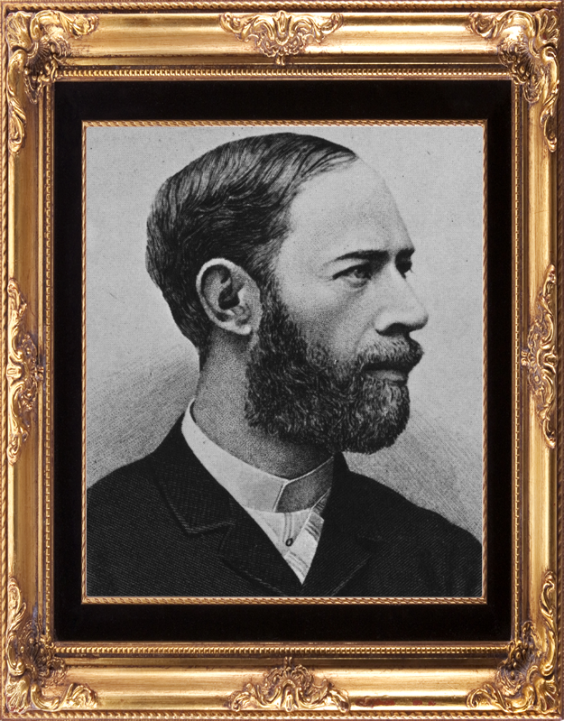
Heinrich Hertz
Astonished at properties of mathematics.
“Mathematical formulas seem to have an independent existence and an intelligence of their own”
Notes:
Kilohertz, Megahertz, etc. named after Heinrich Hertz sees intelligence.
The IEEE Heinrich Hertz Medal, established in 1987, is "for outstanding achievements in Hertzian waves [...] presented annually to an individual for achievements which are theoretical or experimental in nature".
“One cannot escape the feeling that these mathematical formulas have an independent existence and an intelligence of their own, that they are wiser than we are, wiser even than their discoverers, that we get more out of them than was originally put into them.”
Heinrich Hertz (1857–1894)
E.T. Bell. Men of Mathematics. Touchstone (Reissue edition) 1986.

Slide 15
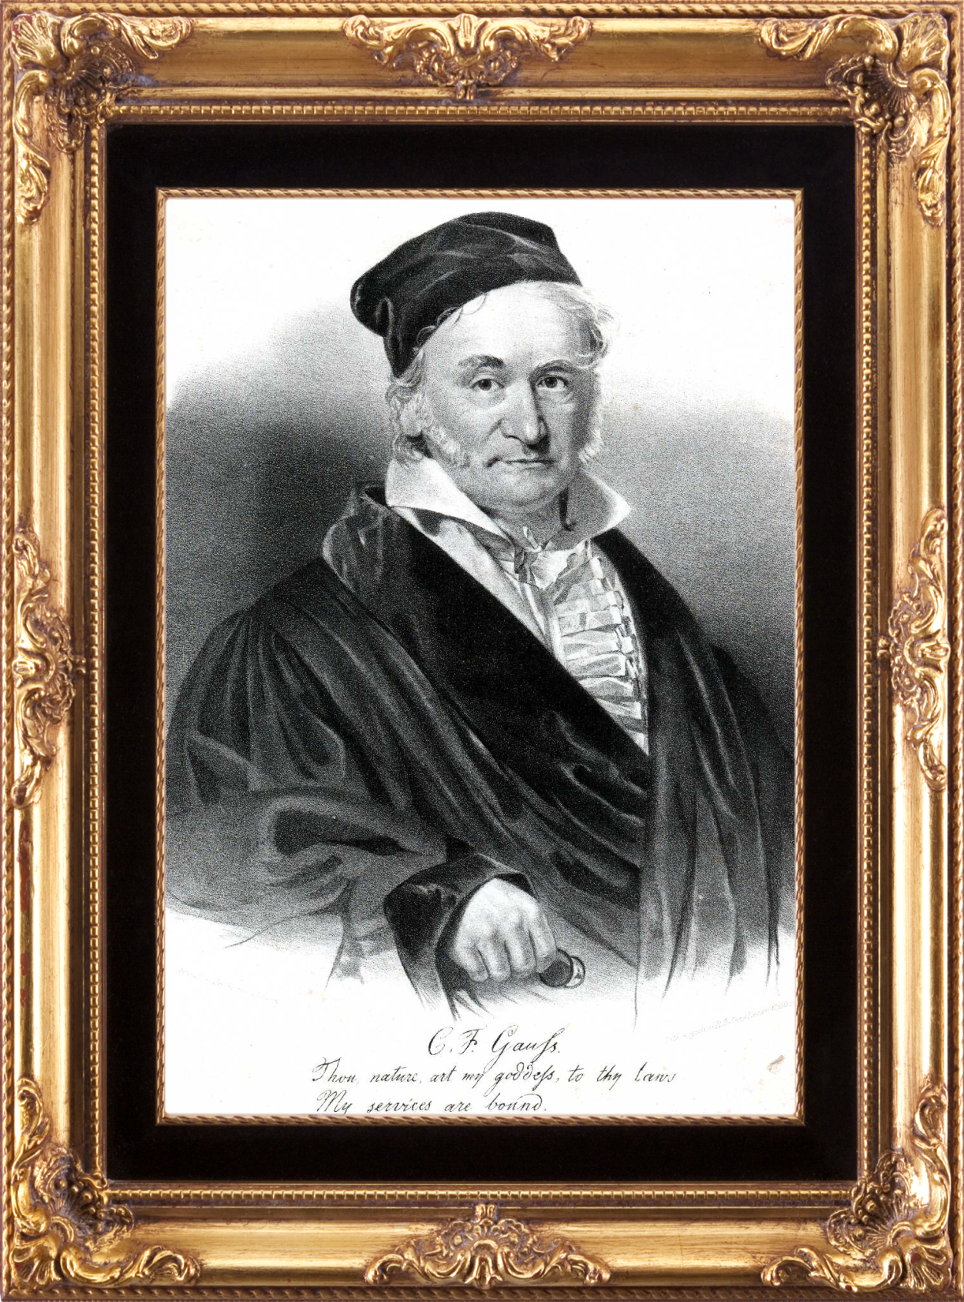
Revelation?
Carl
Friedrich
Gaussß
“by the grace
of the Lord”
Notes:
Finally, two days ago, I succeeded - not on account of my hard efforts, but by the grace of the Lord. Like a sudden flash of lightning, the riddle was solved. I am unable to say what was the conducting thread that connected what I previously knew with what
made my success possible.
Karl Friedrich Gauss (1777–1855)

Slide 16
God Ever Geometrizes: Apologetics in Mathematics
Contents

Apologetics, Provability and God Math
Mathematics is Spooky
Flatland Miracles
To ∞ and Beyond !
The Gödel Effect & the Unknowable
Notes:
Certainly, there is a mystery about mathematics. A supernatural mystery? Maybe in the same sense all creation is supernatural. We are often numbed by familiarity.
Flatland…

Slide 17
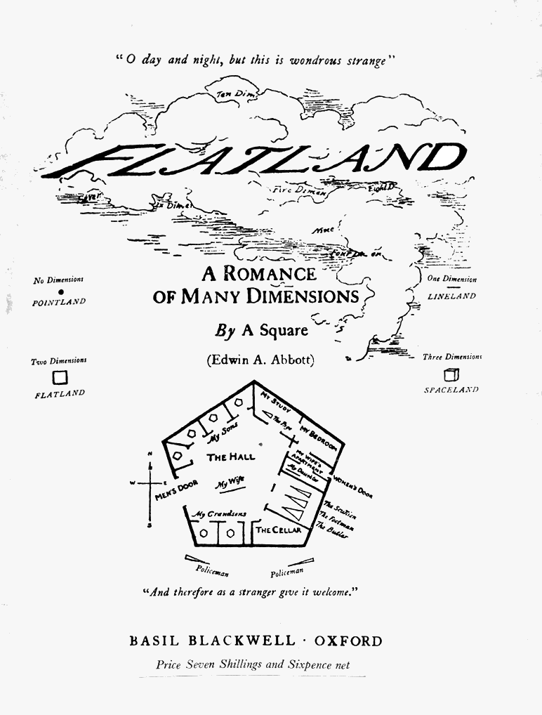
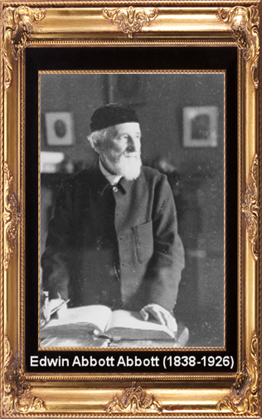
FLATLAND: A Romance of Many Dimensions
Notes:
Edwin Abbott Abbott wrote apologetics, like The Kernel and the Husk where he purported salvation in Christ does not require belief in miracles. [http://www.archive.org/stream/a544557400abbouoft#page/n0/mode/2up ]
Flatland: A Romance of Many Dimensions is an 1884 satirical novella by the English schoolmaster Edwin Abbott Abbott. He wrote pseudonymously as “A. Square"
Isaac Asimov described Abbott’s Flatland as "The best introduction one can find into the manner of perceiving dimensions“
This book had an enormous impact on me as a seeker.
[ The book is online: http://www.geom.uiuc.edu/~banchoff/Flatland/ ]

Slide 18
Flatland by Edwin A. Abbott
(1884)
Lineland
Hmmmm…

Slide 19
Flatland by Edwin A. Abbott
(1884)
Pointland
I am sooooo cool. Wow! Was that me?
Hmmmm…

Slide 20
Flatland by Edwin A. Abbott
(1884)
The Theory of Up

Slide 21
Flatland by Edwin A. Abbott
(1884)
Strange Visitation
Hmmmm…

Slide 22
Flatland by Edwin A. Abbott
The View

Slide 23
Flatland by Edwin A. Abbott
The Request
Notes:
Show me the fourth dimension!
Dimensions are in the literature and movies…

Slide 24
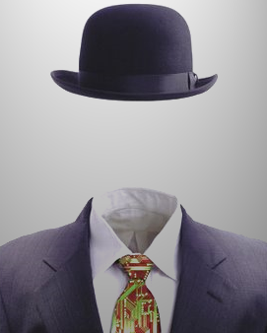
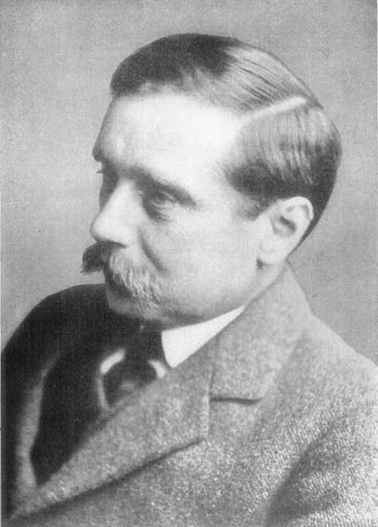
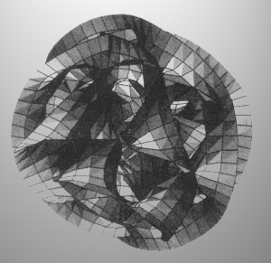
The Invisible
Man
H.G. Wells
“There may be any number of three dimensional Universes packed side by side.”
“I have found a general principle… a formula, a geometric expression involving four dimensions.”
The Wonderful Visit
Cool!
Very Cool!
Notes:
Griffin, the invisible man, explains his discovery to Dr. Kemp.
“The Wonderful Visit” is about colliding universes.

Slide 25
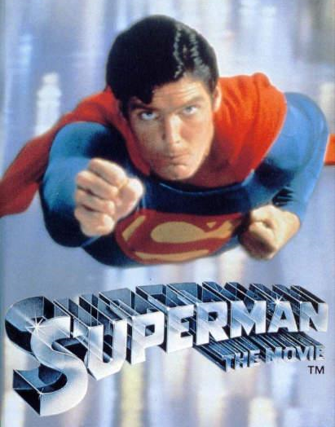
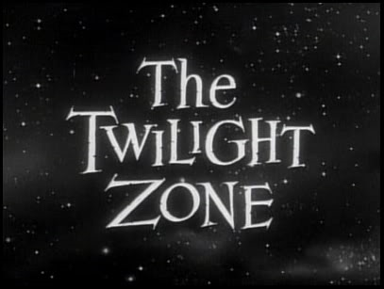
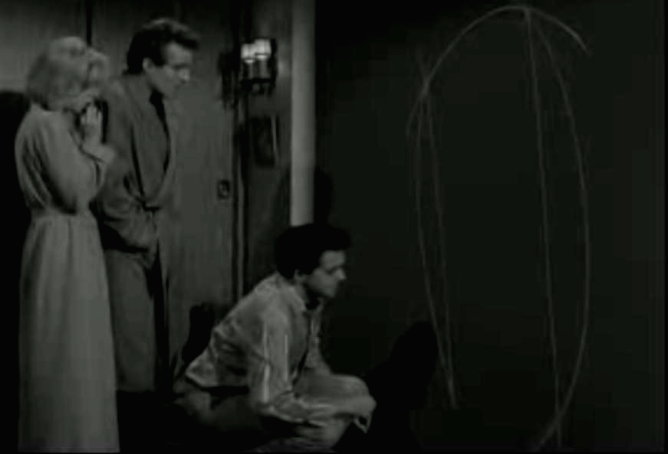
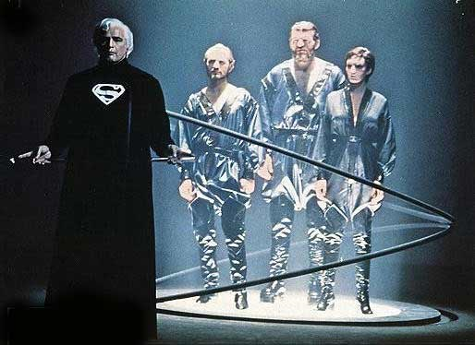
Little Girl Lost
In the Cinema
The Phantom Zone
Notes:
In the cinima
“Little girl lost” on the Twilight Zone.
“The Phantom Zone” in Superman

Slide 26
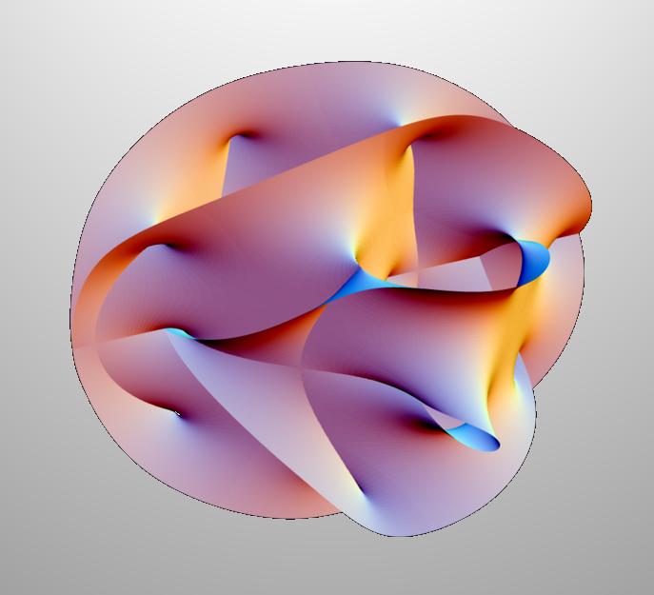
M Theory
11 or 26 Dimensions: Some Compactified.
What of Other Universes?
Dark Matter Explained?
Notes:
Extra dimensions in string theory
11 or 26 Dimensions: Some Compactified.
What of Other Universes?
Dark Matter Explained?

Slide 27

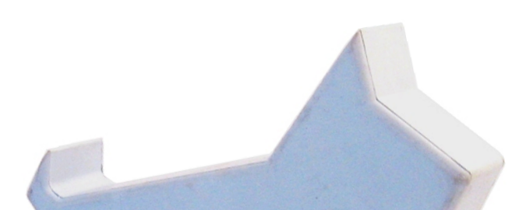
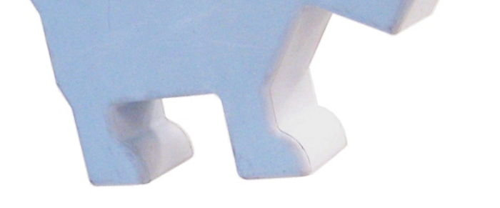
Stephen Hawking’s 2D Dog
Notes:
Dimensional fine tuning.
Stephen Hawking “Otherwise, why should we live in a four dimensional world, and not eleven, or some other number of dimensions. The anthropic answer is that two spatial dimensions, are not enough for complicated structures, like intelligent beings. On the other hand, four or more spatial dimensions would mean that gravitational and electric forces would fall off faster than the inverse square law. In this situation, planets would not have stable orbits around their star, nor electrons have stable orbits around the nucleus of an atom. Thus intelligent life, at least as we know it, could exist only in four dimensions. I very much doubt we will find a non anthropic explanation”
Hawking’s 2D dog, he claims, would break apart along it’s digestive tract.

Slide 28




Properties of High Dimensions
Righties in Flatland
Once a righty – always a righty.
Notes:
Once a righty – always a righty.

Slide 29

Properties of High Dimensions
Once a righty – always a righty?
Not if you can flip in three dimensions.
Notes:
Generalization into higher dimensions underlies the power of visualization in Hilbert spaces.

Slide 30

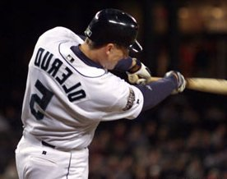
Application to Baseball
Flip into the fourth dimension & back…
Notes:
Everyone in baseball will be a switch hitter.
There is a drawback. There will be frequent confusion as the batter hits the ball and runs towards third base.

Slide 31
Breaking Chains: a Miracle?
Chains in Flatland
Links can be separated in three dimensions.
Notes:
The 2-D chain will be unbroken if we are constrained to two dimensions. In three dimensions, breaking the chain is easy.

Slide 32
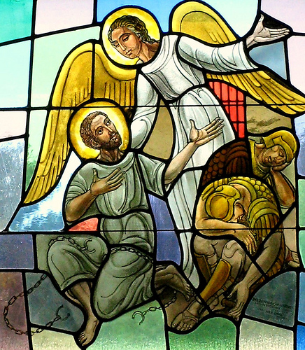
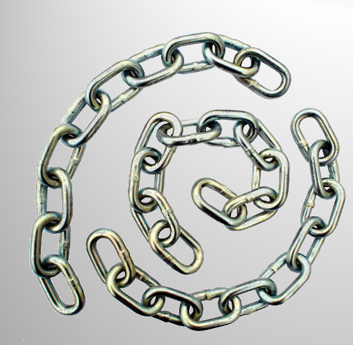
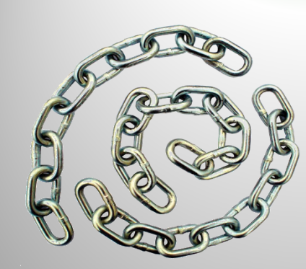
Chains linked in three dimensions can be separated in four.
Acts 12:6 The night before Herod was to bring him to trial, Peter was sleeping between two soldiers, bound with two chains, and sentries stood guard at the entrance.
7 Suddenly an angel of the Lord appeared and a light shone in the cell. He struck Peter on the side and woke him up. "Quick, get up!" he said, and the chains fell off Peter's wrists.
Could this be the explanation of the miracle?
Is this the explanation of the miracle?
yes
maybe

Slide 33

Walking Through Walls: A Miracle?
Locked in a box in Flatland

Slide 34
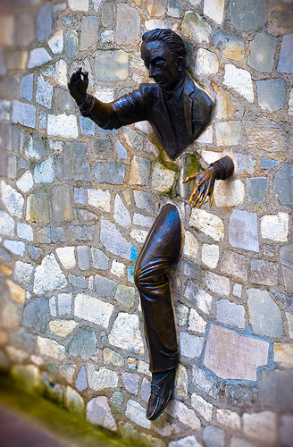
3-D walls are no obstacle in four spatial dimensions
  John 20:26 A week later his disciples were in the house again, and Thomas was with them. Though the doors were locked, Jesus came and stood among them and said, "Peace be with you!"
Could this be the explanation of the miracle?
Is this the explanation of the miracle?
yes
maybe

Slide 35
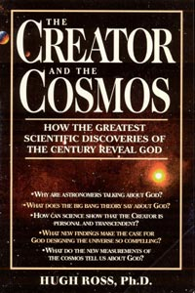
Consequences
A higher dimensional entity
  Can be infinitely close without physical appearance
  Is able to intersect our universe at will
  Is able to see inside you
Explanation of certain miracles (Hugh Ross)
  Walking through walls
  Chains dropping
  Ascension
How Many?
  Larger than countable infinite?
Notes:
Now, to infinity…

Slide 36
God Ever Geometrizes: Apologetics in Mathematics
Contents

Apologetics, Provability and God Math
Mathematics is Spooky
Flatland Miracles
To ∞ and Beyond !
The Gödel Effect & the Unknowable

Slide 37
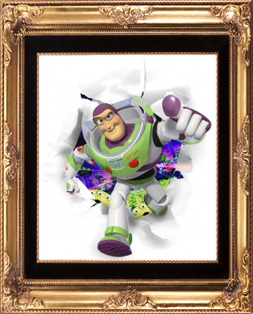
“To Infinity and Beyond!”
∞
∞

Slide 38
INFINITY DICTIONARY
Pronunciation: \in-’fi-nə-tē\
Function: noun
Inflected Form(s): plural in·fin·i·ties
Date: 14th century
1.Calculus. Growing without bound in the limit.
2.Engineering. Really really big.
3.Cantor. The cardinality of a set with an unbounded number of elements.
∞
ℵ
Notes:
Cantor is a founder of set theory.

Slide 39
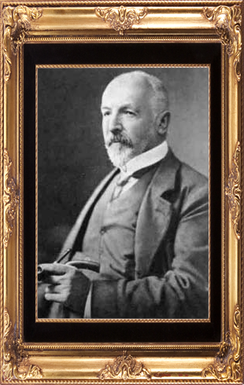
Georg Cantor (1845-1918)
∞
Georg Cantor developed the set theory for transfinite numbers.
ℵ₀
ℵ₁
ℵ₂
ℵ₃
ℵ_{ℵo} ?
Georg Ferdinand Ludwig Philipp Cantor
Notes:
Georg a Protestant, the religion of his father. Georg's mother was a Roman Catholic
Cantor was bipolar and spent time in sanitariums.

Slide 40
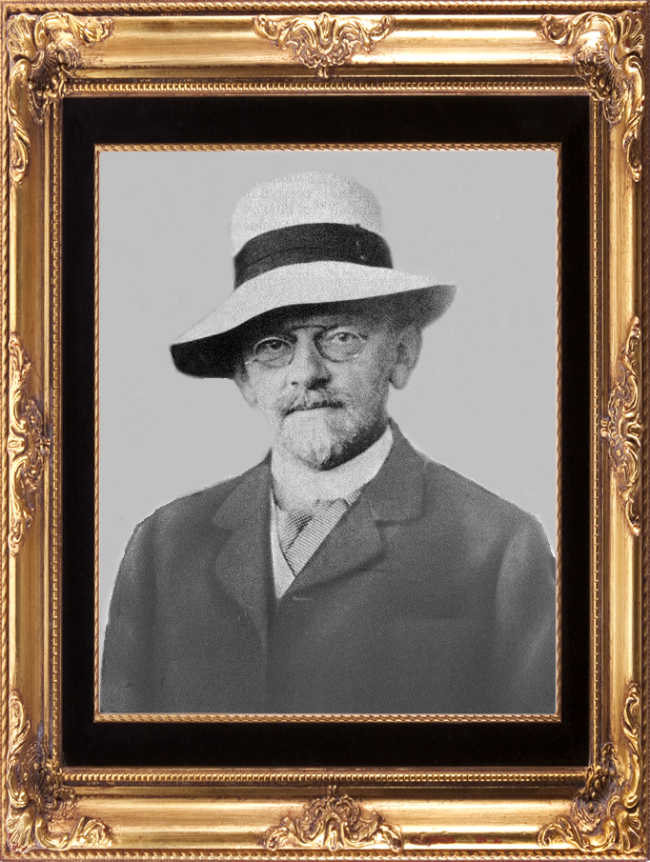
Cantor’s Work
David Hilbert described Cantor's work as:
  “...the finest product of mathematical genius and one of the supreme achievements of purely intellectual human activity.”
“…the infinite is nowhere to be found in reality”
David Hilbert.
Hilbert
David Hilbert
Notes:
Hilbert also said: "No one shall expel us from the Paradise that Cantor has created."
Others were not so nice…
Henri Poincare condemned the theory of transfinite numbers as a “disease” from which he was certain mathematics would someday be cured.
Leopold Kronecker, attacked Cantor personally, calling him a “scientific charlatan,” a “renegade” and a “corrupter of youth.”
http://www-gap.dcs.st-and.ac.uk/%7Ehistory/Mathematicians/Cantor.html

Slide 41
Cantorian Infinities…
The set of all counting numbers
C={1, 2, 3, 4, …} has cardinality ℵ₀ .
Other sets have cardinality ℵ₀ if each element in the set can be placed on a one-to-one correspondence to C.
ℵ₀
WEIRD:
The set of all integers
C₁ ={-3,-2,-1,0,1, 2, 3, 4, …}
has cardinality ℵ₀ .
WEIRD:
The set of all evens
C₂ = { 2, 4, 6, 8, …}
has cardinality ℵ₀ .
WEIRD:
The set of all rationals
C₃ ={ x | x = ^{m}/_{n} }
has cardinality ℵ₀ .
WEIRD:
The set of all primes
C₄ = { 2, 3, 5, 7, 11, 13, …}
has cardinality ℵ₀ .
Notes:
Cardinality = The number of elements in a set.

Slide 42
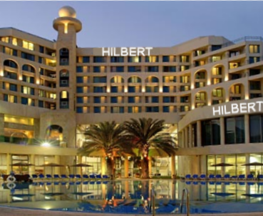
HILBERT’s Hotel
There are ℵ₀ rooms numbered 1,2,3,…
All Rooms Are Full.
A New Guest Comes…
  No Problem
10 New guests Come…
  No Problem
ℵ₀ New Guests Come…
  No Problem
Notes:
Hilbert’s Hotel. A strange

Slide 43
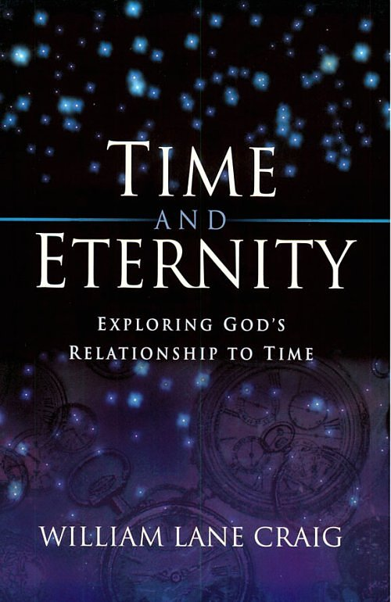
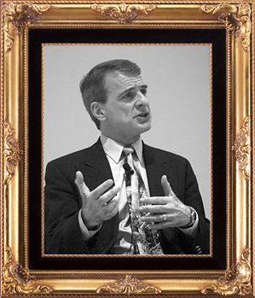
William Lane Craig:
Creation & Infinity
Notes:
Two ways to prove creation: Way #2 is with infinite time and creation.
“…since the actual infinite cannot exist and infinite temporal regress of events is an actual infinite, we can be sure that an infinite temporal regress of events cannot exist, that is to say, the temporal regress of events is finite. Therefore, since the te
“To try to instantiate an actual infinite progressively in the real world would be hopeless, for one could always add one more element.” (ℵ₀ versus ∞.)
ReasonableFaith.org
mporal regress of events is finite, the universe began to exist.”

Slide 44
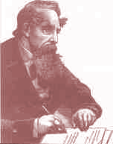
Tristram Shandy Paradox
Writing from t = 0 onward:
N years
0 t
N days
Bummer
Tristram will fall further and further behind.

Slide 45
Tristram Shandy Paradox
Writing from the past to end at t = 0:
N years
t
N days
Cool
This is
Absurd!!
No matter how big N, there is always time for Tristram to finish: even if N = ℵ₀.
Notes:
Tristram Shandy Paradox (Russell): If Tristram Shandy wrote his autobiography 365 times as slow as he lived life, he could live ℵ₀ days and be finished with his autobiography now. (Or why not yesterday?) We have no idea!
Craig concludes “… an infinite temporal regress is absurd.”
Thus: Time and the universe are finite. The universe must have had a beginning.

Slide 46
Tristram Shandy Paradox
Writing from t = 0 onward:
N years
0 t
N days
Weird
But! If the future is infinite, Tristran will finish his work.
Notes:
Also, time will end. Otherwise, Tristram will finish his work even if he starts now.

Slide 47
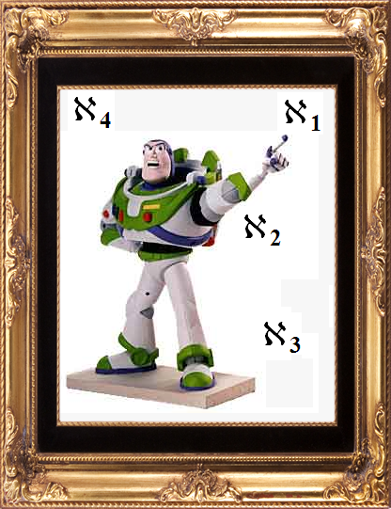
to ℵ₀ AND BEYOND!
ℵ₁
The set of all subsets of a set with ℵ₀ elements is of cardinality ℵ₁. This is a “bigger” infinity.
ℵ₁=2^{ℵ0}
ℵ_{n +1}=2^{ℵn}
Notes:
Beyond ℵ₀ ?

Slide 48
Cantorian Infinities…
The set of all points on the unit interval
C={ x | 0 < x < 1 } has cardinality ℵ₁ .
Other sets have cardinality ℵ₁ if each element in the set can be placed on a one-to-one correspondence to C.
ℵ₀
WEIRD:
The set
C₁ ={ x | 0 < x < 10 }
has cardinality ℵ₁ .
WEIRD:
The set of point on a ray
C₂ = { x | 1 < x < ∞ }
has cardinality ℵ₁ .
WEIRD:
The set of point in a square
C₃ = {(x,y)| 0 < x,y < 1 }
has cardinality ℵ₁ .
WEIRD:
The set of point in a cube
C₄ = {(x,y,z)| 0 < x,y,z < 1 }
has cardinality ℵ₁ .
Notes:
"I see it but I don't believe it.” Georg Cantor on his own theory.

Slide 49
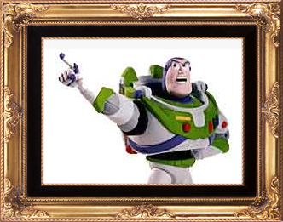
… AND BEYOND…
ℵ₂ = the set of all scribbles.
ℵ₂
a
a

Slide 50
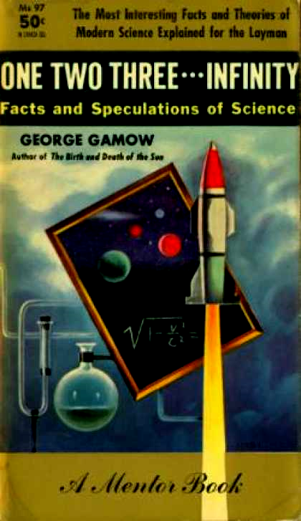
GRORGE GAMOW and OUR LIMITATIONS
1
One
Two
Three
Many
2
3
many
Notes:
One two three ... infinity: Facts and speculations of science George Gaov,
Dover Publications; 1 edition (September 1, 1988) Originally published 1947
Gamow produced an important cosmogony paper with his student Ralph Alpher, which was published as "The Origin of Chemical Elements" (Physical Review, April 1, 1948). This paper became known as the Alpher-Bethe-Gamow theory. Gamow had the name of Hans Bethe listed on the article as "H. Bethe, Cornell University, Ithaca, New York" to make a pun on the first three letters of the Greek alphabet, alpha, beta and gamma. Bethe had not had any other role in the α-β-γ paper.

Slide 51
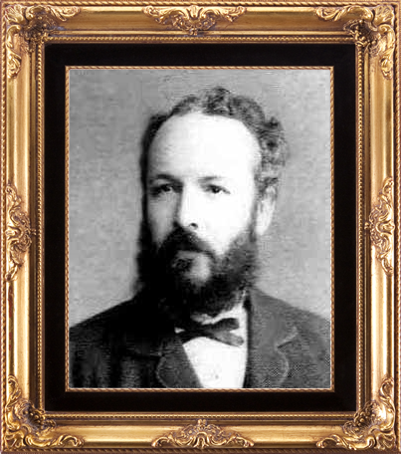
∞
wow
There is no “biggest” infinity!
ℵ₀
ℵ₁
ℵ₂
ℵ₃
ℵ_{ℵo}
ℵ
ℵ₃
ℵ_{ℵ}
Georg Ferdinand Ludwig Philipp Cantor
ℵ_{ℵ}
ℵ_{ℵo}
Notes:
Anselm’s ontological argument contends God is greater than this.
Contrast with the “prime mover”
When we talked about dimensions, what about ℵ₀
Dimensions? (We have them in some Hilbert spaces.) ℵ₁ dimensions (continuum Hilbert space.) How about bigger? Is God there?

Slide 52
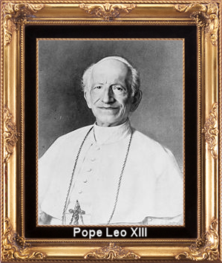
MeanwHILE, Over at Rome…
Pope Leo III’s Encyclical Aeterni Patris
Cantor was being beat up with peer review.
Cantor interacted with the church.
Like Gauss, Cantor believed the mathematics had been revealed to him by God.
Cantor related his work to God.
Notes:
1. Leo XIII (1810-1903) in his Encyclical Aeterni Patris, expressed his interest in reassessing the directions of Christian philosophy, in attempting to reconcile the new and often perplexing discoveries of science with scripture and authorities of the Church, encouraged a number of Catholic intellectuals to study the various branches of natural science in detail.
2. In 1877, Kronecker tried to prevent the publication of a paper Cantor had
written which showed that spaces of different dimension could be uniquely matched in a one-to-one correspondence regardless of the dimensions involved. Henri Poincare condemned the theory of transfinite numbers as a “disease” from which he was certain mathematics would someday be cured. Leopold Kronecker, attacked Cantor personally, calling him a “scientific charlatan,” a “renegade” and a “corrupter of youth.”
3. Cantor wrote the Pope and was in dialog with the Pope’s investigators. Cantor was always proud of the acceptance his new theory had found in the estimation of Franzelin, and would frequently remind his friends in the Church, through correspondence, that he had been assured on the Cardinal's authority that the theory of transfinite numbers
posed no theological threats to religion
4. [Note: Gauss was wary of transfinite numbers.] Cantor believed he was not the creator of his new work, but merely a reporter. God had provided the inspiration, leaving Cantor responsible only for the way in which his articles were written. “I entertain no doubts as to the truth of the transfinites, which I have recognized with God's help and which, in their diversity, I have studied for more than 20 years; every year, and almost every day brings me further in this science.”
5. Cantor said "...the transfinite species are just as much at the disposal of the intentions of the Creator and His absolute boundless will as are the finite numbers."
Source: Joseph W. Dauben, "Georg Cantor and Pope Leo XIII: Mathematics, Theology, and the Infinite,“ Journal of the History of Ideas, Vol. 38, No. 1. (Jan. - Mar., 1977), pp. 85-108.
http://links.jstor.org/sici?sici=0022-5037%28197701%2F03%2938%3A1%3C85%3AGCAPLX%3E2.0.CO%3B2-I

Slide 53
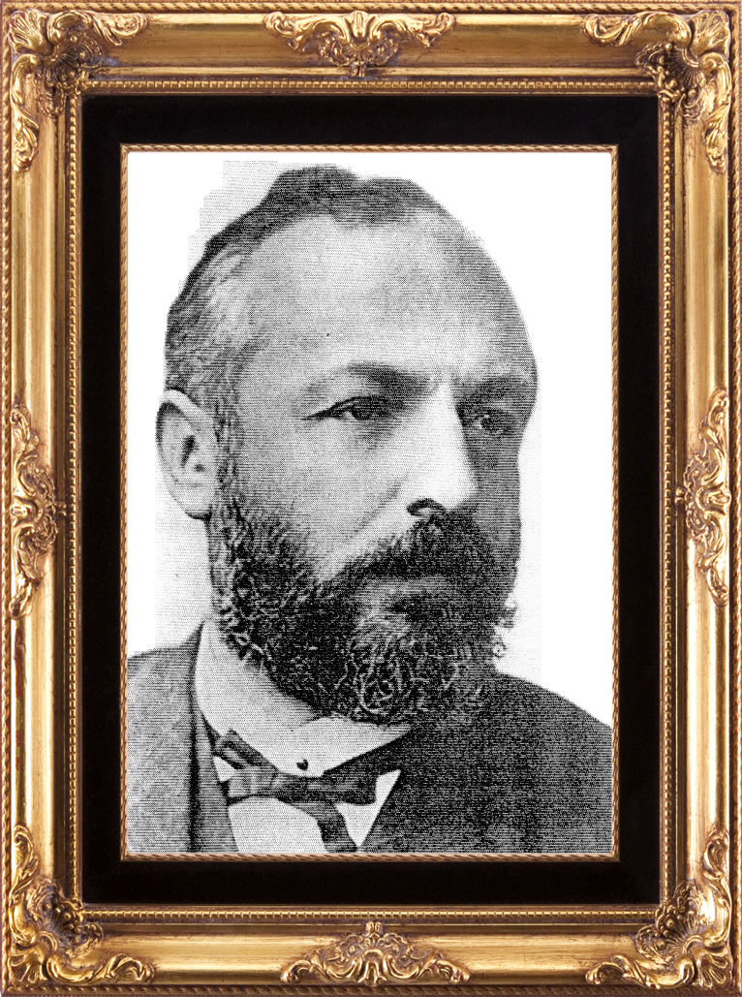
Cantor’s Belief
“…the transfinite species are
just as much at the disposal of the intentions of the Creator and His
absolute boundless will as are the finite numbers.“
Notes:
“The actual infinite arises in three contexts: first when it is realized in the most complete form, in a fully independent otherworldly being, in Deo, where I call it the Absolute Infinite or simply Absolute; second when it occurs in the contingent, created world; third when the mind grasps it in abstracto as a mathematical magnitude, number or order type”
Cantor believed he was seeing scripture, in part. "The time will come when these things which are now hidden from you will be brought into the light"
The art of the infinite: the pleasures of mathematics
By Ellen Kaplan

Slide 54
God Ever Geometrizes: Apologetics in Mathematics
Contents

Apologetics, Provability and God Math
Mathematics is Spooky
Flatland Miracles
To ∞ and Beyond !
The Gödel Effect & the Unknowable
Notes:
“God Ever Geometrizes” Plato
What is the role of apologetics?

Slide 55
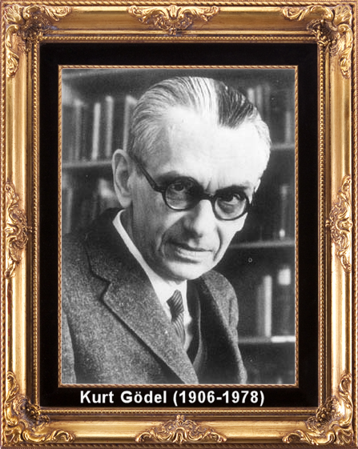
Algorithmic Information THeory
Kurt Gödel’s consistency & completeness theorems
Theorem X: Theorem X Cannot be proved
Notes:
A little theory goes a long long way…

Slide 56
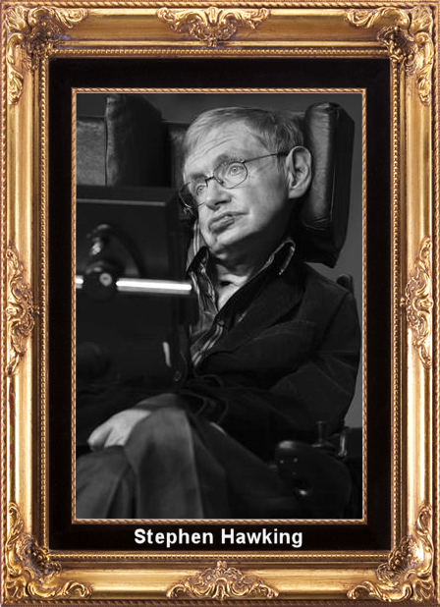
Stephen Hawking
"Gödel and the end of physics“
Consequence:
Hawking is now a TOE Agnostic
Notes:
“Up to now, most people have implicitly assumed that there is an ultimate theory, that we will eventually discover. Indeed, I myself have suggested we might find it quite soon. However, M-theory has made me wonder if this is true. Maybe it is not possible to formulate the theory of the universe in a finite number of statements. This is very reminiscent of [sic] Goedel's theorem. This says that any finite system of [sic] axyoms, is not sufficient to prove every result in mathematics.” Feb 23, 2004
http://www.damtp.cam.ac.uk/strings02/dirac/hawking/

Slide 57

Roger Penrose
Gödel Shows Humans are Not Computers (Turing Machines)
Notes:
Penrose’s idea: Gödel's proof of his first incompleteness theorem shows that human mathematics cannot be captured by a formal system F: the Gödel sentence G(F) of F can be proved by a (human) mathematician but is not provable in F.

Slide 58

Things that we can prove don’t exist
The Halting Problem
Rice’s Theorem
Notes:
Rice, H. G. "Classes of Recursively Enumerable Sets and Their Decision Problems." Trans. Amer. Math. Soc. 74, 358-366, 1953. [From doctoral dissertation

Slide 59

Determinism and Knowability
11.
00100100 00111111 01101010 10001000 10000101 10100011 00001000 11010011 00010011 00011001 10001010 00101110 00000011 01110000 01110011 01000100 10100100 00001001 00111000 00100010 00101001 10011111 00110001 11010000 00001000 00101110 11111010 10011000 11101100 01001110 01101100 10001001 01000101 00101000 00100001 11100110 00111000 11010000 00010011 01110111 10111110 01010100 01100110 11001111 00110100 11101001 00001100 01101100 11000000 10101100 00101001 10110111 11001001 01111100 01010000 11011101 00111111 10000100 11010101 10110101 10110101 01000111 00001001 00010111
Notes:
Laplace determinism and its quantum mechanical generalization.
Cantor also believed that his theory of transfinite numbers ran counter to both materialism and determinism—and was shocked when he realized that he was the only faculty member at Halle who did not hold to deterministic philosophical beliefs.
Lap

Slide 60

Chaitin’s Mystical,
Magical Number.
Ω
Ω
Ω
Ω
Ω
Ω
Ω
Ω
Ω
Ω
Ω
Ω
Ω
Ω
Ω
Ω
Ω
Ω
Ω
Ω
Gregory Chaitin
Notes:
Chaitin’s number cannot be called “God of the gaps” since it is unknowable.

Slide 61


Chaitin=Kolmogorov-Solomonoff Theory
Chaitin’s Conclusion: Of all of the things that are true, most cannot be derived from basic axioms or physical laws.
They are true because they are true.
Notes:
Final notes:
We have seen how algorithmic information theory proves there are things that exist that are not knowable.
Dimensions are beyond our comprehension.
The largest infinity is beyond our comprehension.
God existing in the largest dimension is beyond our comprehension.
But Anselm argues God is even greater than that.

Slide 62

Notes:
Solomon’s Sage advice: Ecclesiastes 12b:13
11 The words of the wise are like goads, their collected sayings like firmly embedded nails-given by one Shepherd.
12 Be warned, my son, of anything in addition to them.
12b. Of making many books there is no end, and much study wearies the body.
13. Now all has been heard; here is the conclusion of the matter: Fear God and keep his commandments, for this is the whole [duty] of man.

Slide 63
Finis
Finis
Finis
Finis
Finis
Finis

Slide 64





POSTERS OF FAMOUS SCIENTISTS with quotes about their Christian faith:
RobertMarks.org
Click: Apologetics, then posters

Slide 65


God Ever Geometrizes:
Apologetics in Mathematics
Robert J. Marks II, Ph.D.
Distinguished Professor of Electrical
& Computer Engineering.
Baylor University
Tuesday, December 1, 2009, Room 109, Rogers Bldg. 5:30. Pizza & Drink.
Abstract: Heinrich Hertz (1857–1894) said “One cannot escape the feeling that … mathematical formulas have an independent existence and an intelligence of their own, that they are wiser than we are, wiser even than their discoverers, that we get more out of them than was originally put into them.” There are numerous instantiations of Hertz’s observation. We will discuss why Georg Cantor (1845-1918) took his work in transfinite numbers to the Vatican. How did Karl Friedrich Gauss (1777–1855) believe God was involved in his mathematics? How did Blaise Pascal (1623-1662) use set theory and probability to argue for God’s existence? What numbers did Gottfried Wilhelm Leibniz (1646–1716) say are the “fine and wonderful recourse of the divine spirit, almost an amphibian between being and not being.” How did Kurt Gödel (1906–1978) mathematically prove Anslem’s ontological argument for God’s existence? How did an 18th century monk generalize existence to higher dimensions that offer explanations of Biblical miracles? How does Gregory Chaitin (1947- ) mathematically prove there are astonishing things that exist that are unknowable? And how does Rice’s Theorem shed light on a consistency between determinism and knowability? Stephen Hawking (1942- ) claims no theory in science can be proven. We simply accumulate evidence. Like all apologetics, these insights of mathematics do not prove God’s existence nor Christianity. But they add to the accumulation of evidence.
This talk, although accessible by those not well versed in mathematics, provides references for deeper study by those who are.
Sponsored by the Baylor Society for Conversations in Religion, Ethics and Science & the Baylor Student Chapter of the American Scientific Affiliation

